Slide 1
Session 1: Introduction to Carbon Literacy and the Science of Climate Change
Adapted for the University of Worcester by Jess Tasney, Sian Evans, Katy Boom

Slide 2
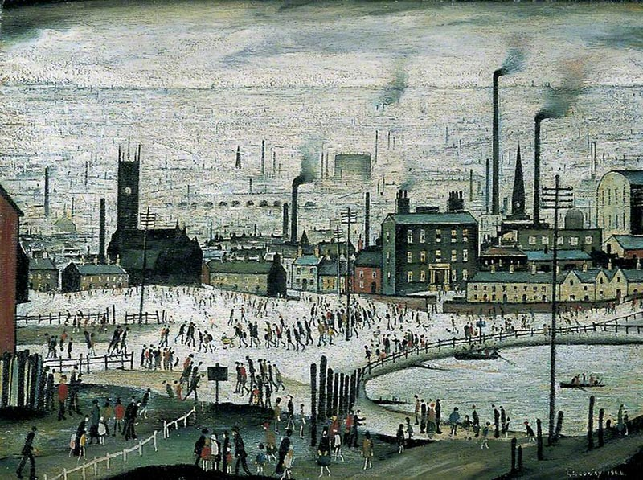
Introduction
Training follows wide success in the television and film industry
It all began in Manchester…

Slide 3
What is Carbon Literacy?
An awareness of the carbon dioxide costs and impacts of everyday activities and the ability and motivation to reduce emissions on an individual, community and organisational basis.
The focus of this course is to empower you to choose your own climate solutions.
To be awarded certification, you must complete eight hours of training and pass a short assessment to the required standard.

Slide 4
Carbon Literacy Project

Slide 5
During the training you will:
 | Session 1 - Science | Session 2 - Impacts
The Problem | Learn about the science of climate change Your individual carbon footprint | Examine the impacts of climate change Explore the distribution of impacts and reflect on climate justice Consider possible future scenarios
 | Session 3 – Action 1 | Session 4 – Action 2
The Solutions | Learn about action on climate change (including mitigation and adaptation) at various scales Compare high and low carbon footprint actions Devise high impact individual strategies | Consider ‘multisolving’ climate solutions Devise high impact group strategies
“Providing you with the tools to make a difference….”

Slide 6
Register
If you want to apply for the CL certificate, you need to attend all four sessions (8 hours) and fill in an assessment form.
If you have any question regarding the organisation of this training
Please contact: J.tasney@worc.ac.uk
www.ntu.ac.uk

Slide 7
Session 1: Learning Outcomes
Introduction to the training
Introduction to the basics of climate science
Calculating your individual / household carbon footprint
Independent learning task

Slide 8
Introductory film and questions
Link: https://www.bbc.co.uk/news/av/world-57868135
This is an introductory film highlighting the immediacy of the climate emergency and the need for urgent action, the content of which will be built on further today and during other sessions.
After the film you will go into break out groups to:
A) Introduce yourself to the group
B) Give one reason why you are attending the training
C) Highlight one thing from the video that stood out for you

Slide 9
Group feedback on the video
Please can one person from each group provide some feedback on the group’s reactions to the video.

Slide 10
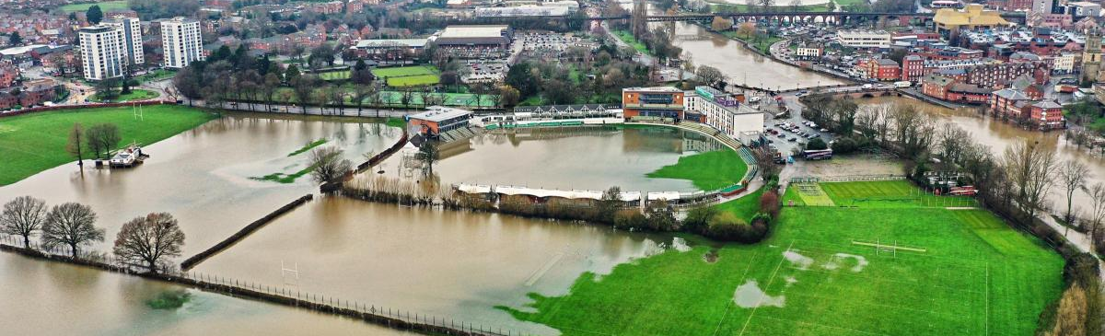
What is happening locally?
We saw from introductory video that the earth’s climate has changed and some of the global impacts.
Climate change is affecting us all, use the chat to give some local examples.

Slide 11
The Carbon Cycle

Slide 12
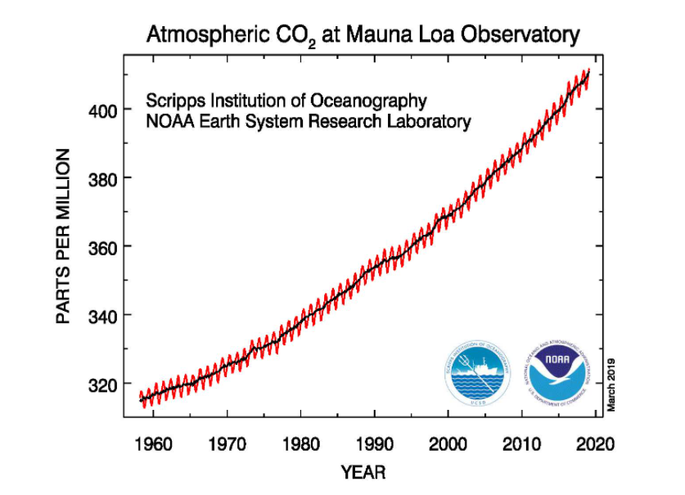
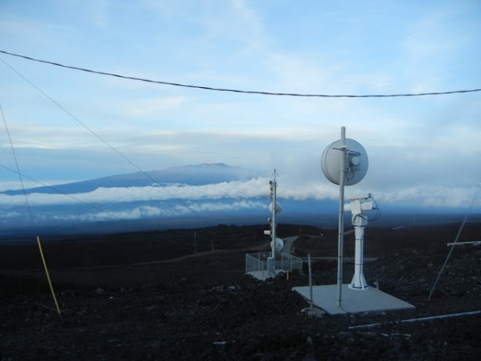
CO₂ Levels Rising
Notes:
Source: https://gml.noaa.gov/ccgg/trends/mlo.html

Slide 13
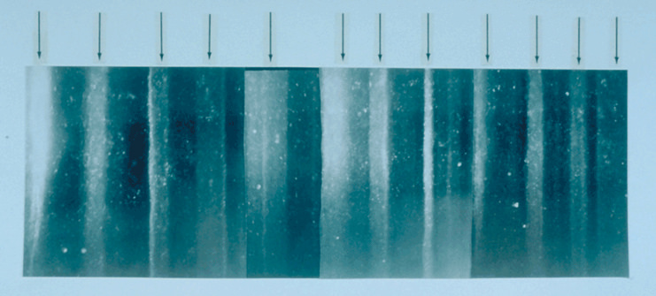
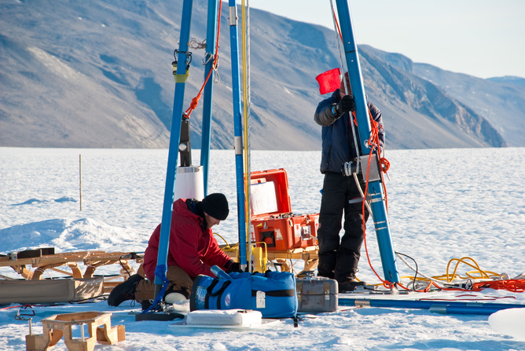
What do ice cores measure?
Ice cores reveal historic levels of CO₂

Slide 14
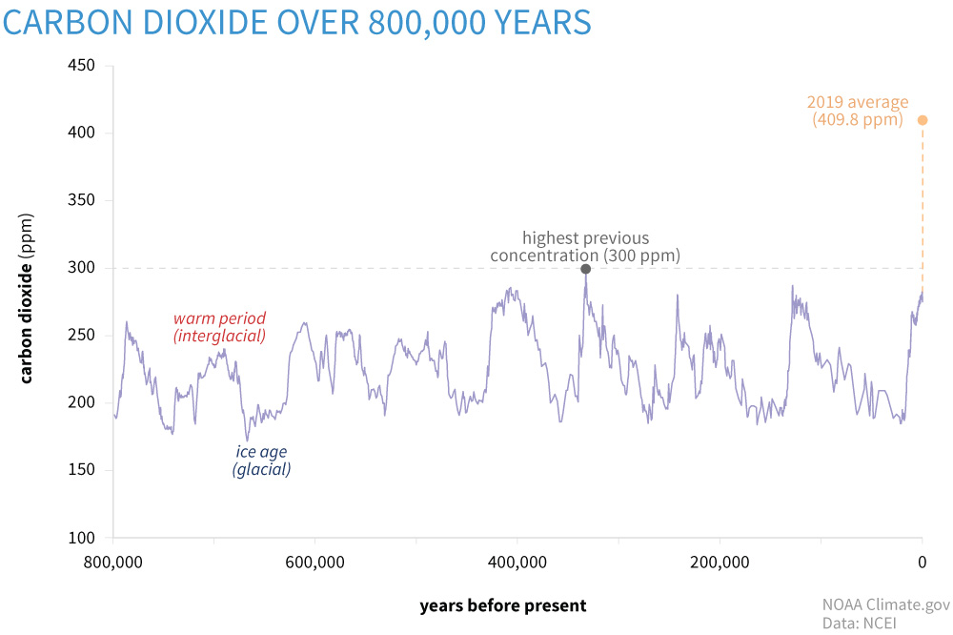
2020 average: 413.94 ppm
Notes:
Source: https://www.climate.gov/news-features/understanding-climate/climate-change-atmospheric-carbon-dioxide
This graph has been put together using such proxy measures to show how CO2 levels have changed over the past 800,000 years. The highest historic CO2 level was 400,000 years ago when it peaked at 300ppm. As you can see this has risen significantly with the 2020 annual average at 413.94ppm

Slide 15
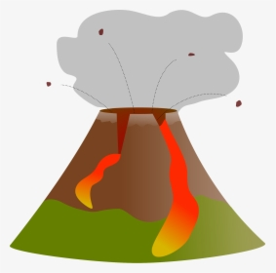
Natural v anthropogenic (man-made) climate change
The causes of climate change can be considered in two broad categories: natural causes and anthropogenic causes.
Natural causes refer to natural phenomena that are not related to human activity which cause climate change, including volcanic and solar activity
Anthropogenic causes refer to human activities that cause climate change
Notes:
Climate change has occurred naturally since the very beginnings of our planet and historically we have seen several climate change event, including the Ice age. In the historic past climate change was only caused by natural changes or events, such as volcanic and solar activity, however since humans industrialised, we have released, and continue to release huge amounts of greenhouse gases that cause climate change into the atmosphere.

Slide 16
Natural or Anthropogenic?
Changes to Earth’s orbit
Burning gas to generate energy
Intensive agriculture
Deforestation
Using aerosols
Solar flares
Causes of climate change
Driving petrol/ diesel vehicles
The aviation industry
Sending waste to landfill
Volcanic eruptions
Notes:
Take a look at the different causes of climate change. On this slide there are ten causes, both natural and anthropogenic. Put in the chat how many are man-made.
Note: Click to reveal three manmade.
Have a think about which of these causes might have the most significant impact and whether any of them are causes you can address in your daily life?

Slide 17
How does human activity cause climate change?
Greenhouse gases are gases in the Earth’s atmosphere that trap heat from the Sun in our atmosphere.
Greenhouse gases do occur naturally. However human activities such intensive farming of livestock, and burning of fossil fuels like coal, gas and oil for energy release huge amount of greenhouse gases into the atmosphere.
Deforestation has also left the Earth with far fewer trees to absorb CO2 from the atmosphere.

Slide 18
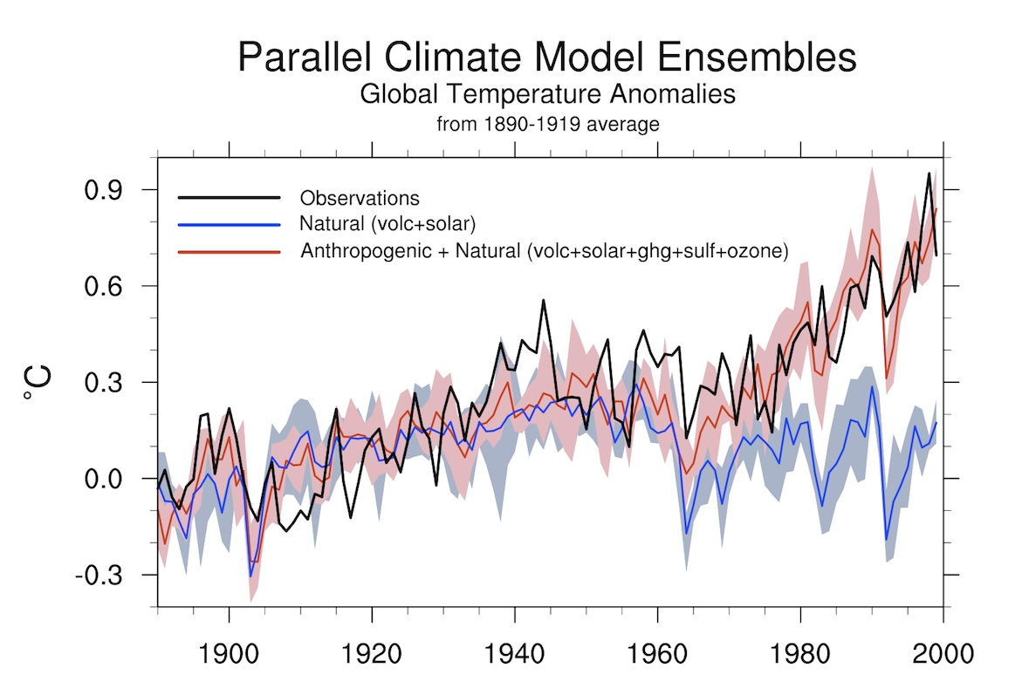
Anthropogenic climate change
In 2021, the Intergovernmental Panel on Climate Change said:
It is “unequivocal that human influence has warmed the atmosphere, ocean and land”.
Scientific consensus – ‘indisputable that climate change is caused by human activities’
Prof Ed Hawkins, 2021
Notes:
Source: http://ossfoundation.us/projects/environment/global-warming/myths/images/models/Mheel_Attribution-72-1200w.jpg/image_view_fullscreen

Slide 19
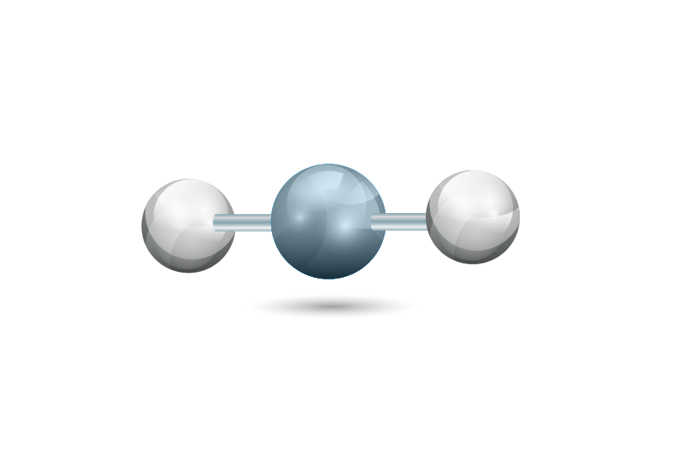
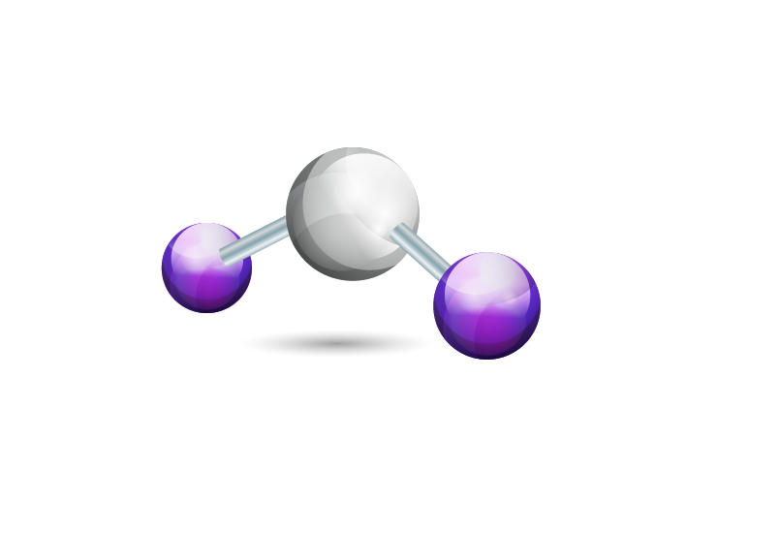
The Greenhouse Gases
Carbon Dioxide (CO₂)
Methane (CH₄)
Nitrous Oxide (N₂O)
F Gases (various)
1
25
298
10s to 10,000s
Global warming potentials
CO2e
Notes:
Give a basic explanation of the main greenhouse gases and the term ‘global warming potential’ to learners.
Carbon Dioxide (CO₂)
Methane (CH₄)
Nitrous Oxide (N₂O)
F Gases
Global warming potential
Ability to trap heat e.g. Methane absorbs much more heat energy than CO₂
Length they stay in the atmosphere e.g. Methane lasts ~ a decade in the atmosphere, much less time than CO₂.
Main contributor to global warming = CO₂ due to quantity emitted
Reference to ‘carbon’ = all greenhouse gases
Images: See copyrighting document for image licenses
Figure 11: Greenhouse Gas Molecules

Slide 20
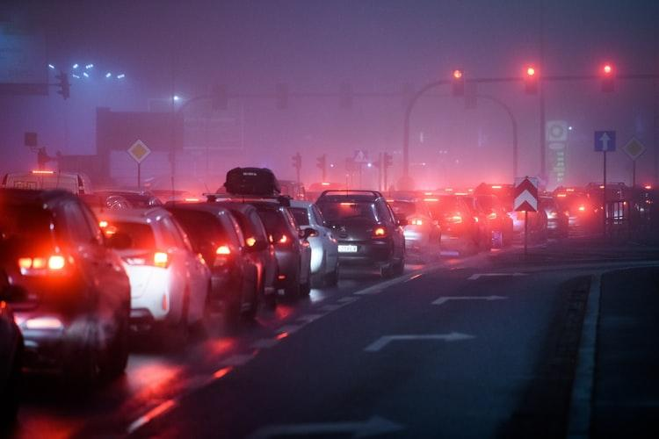
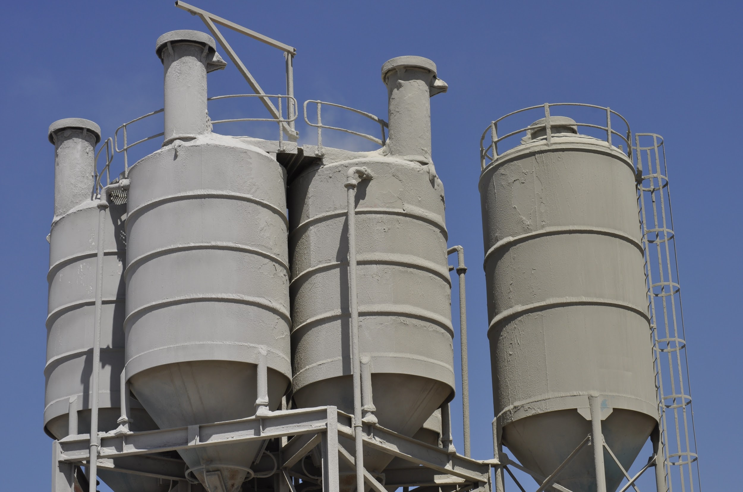
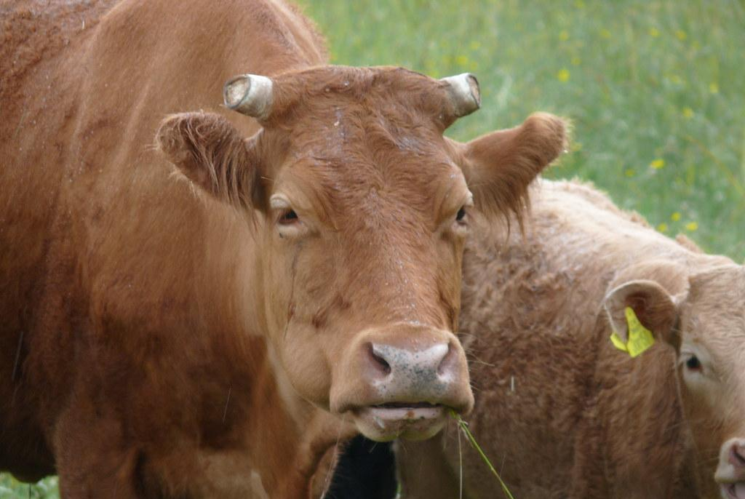
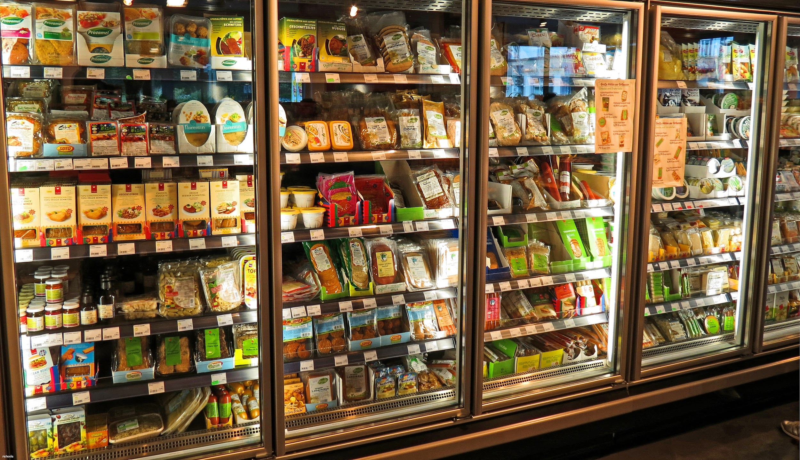
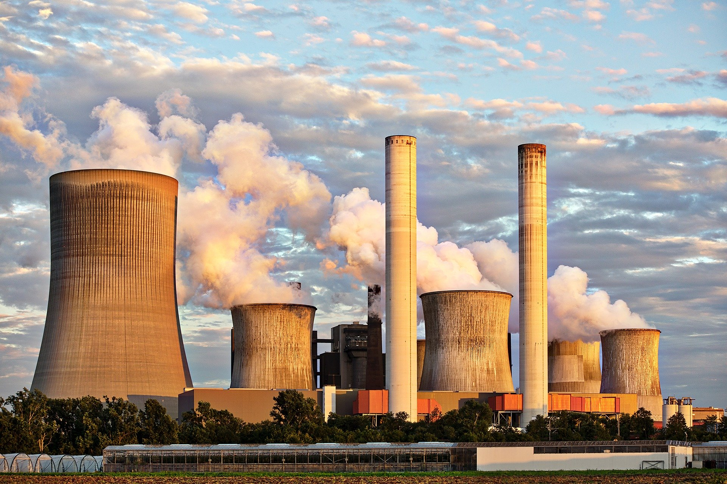
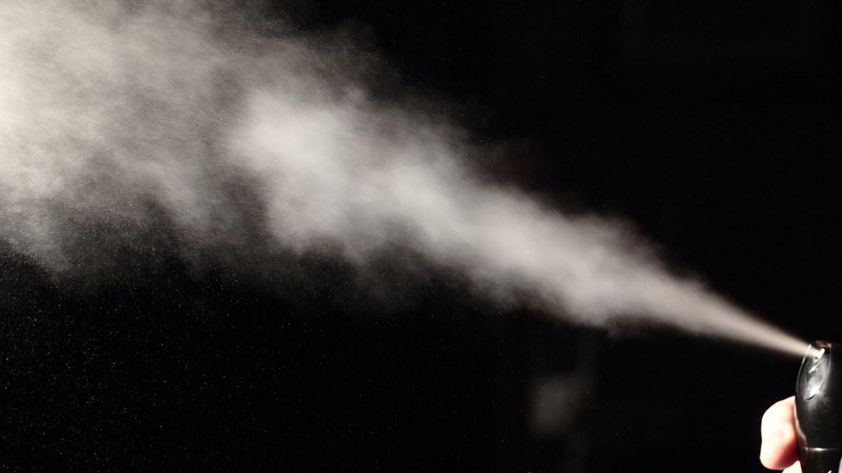
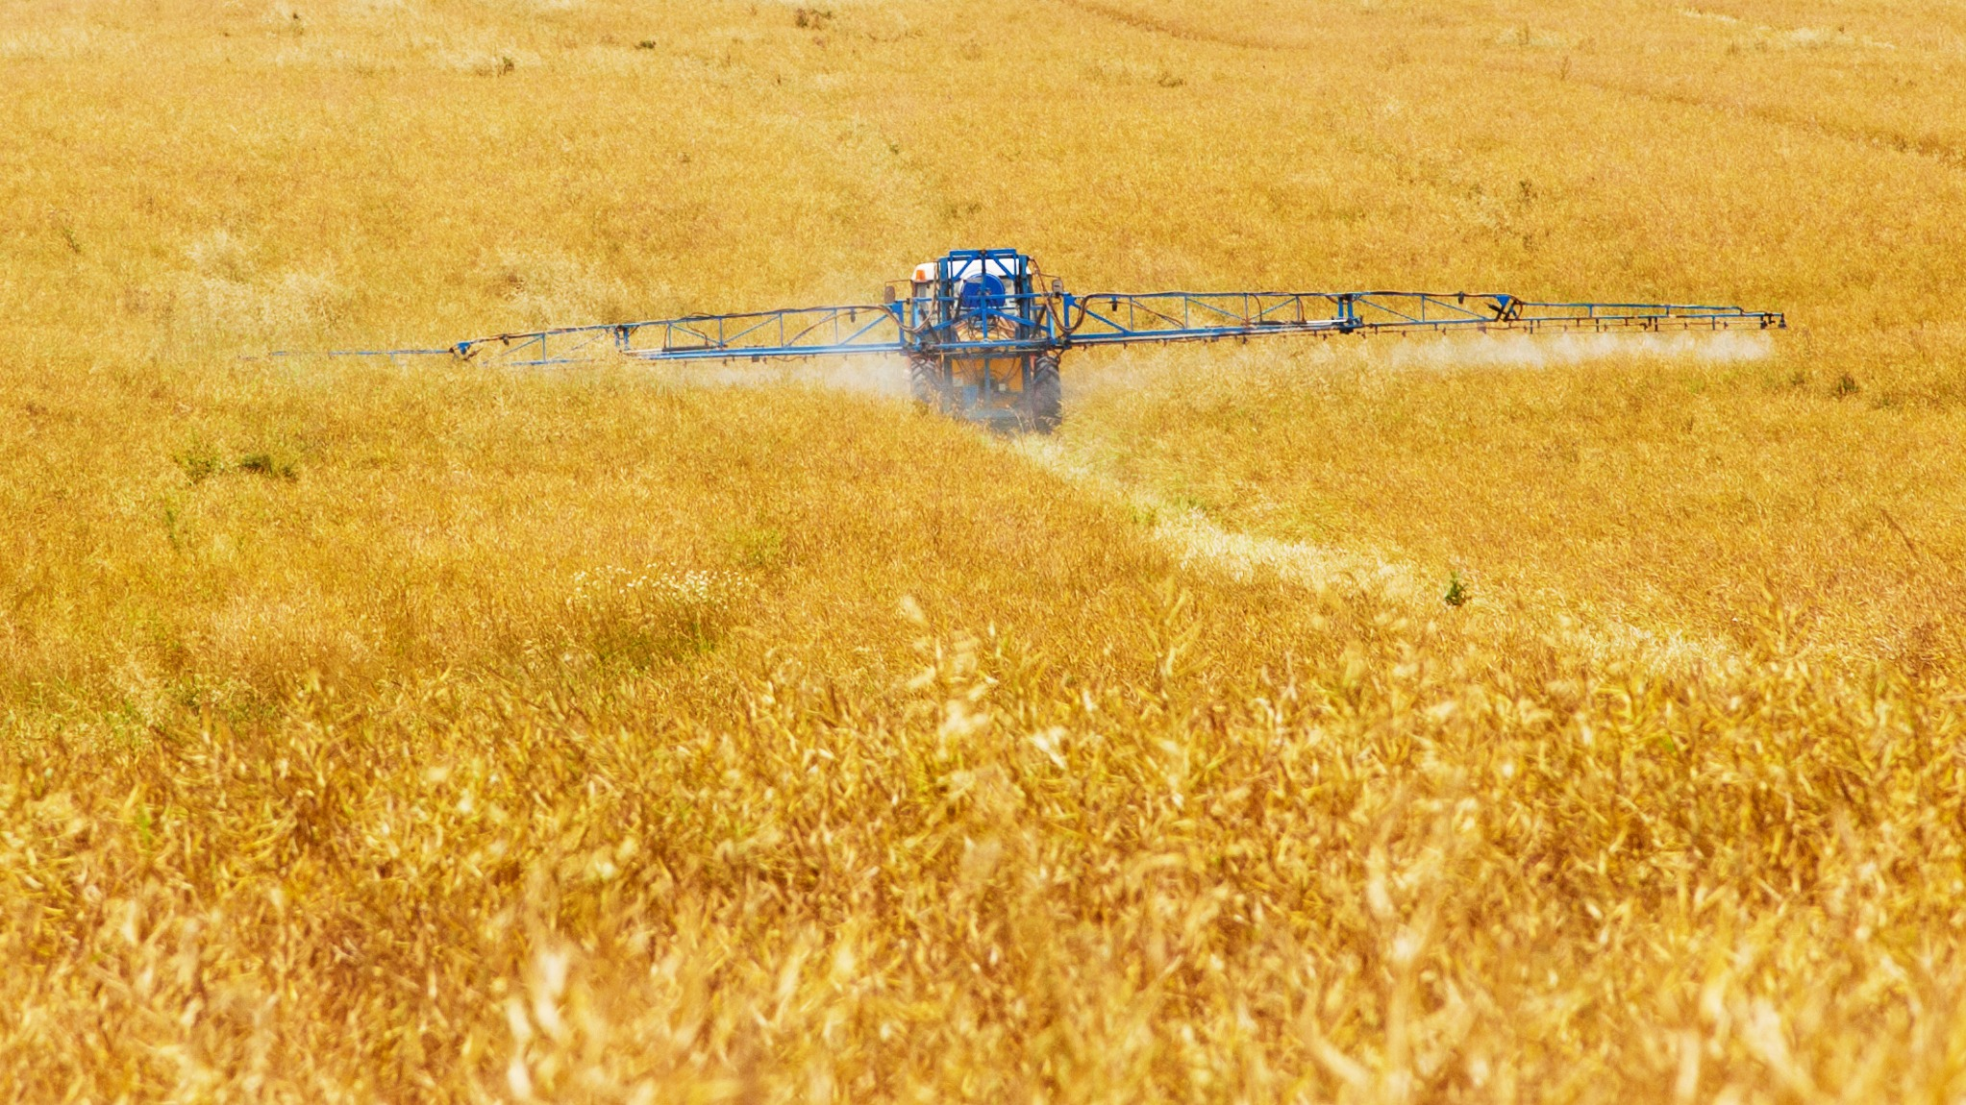
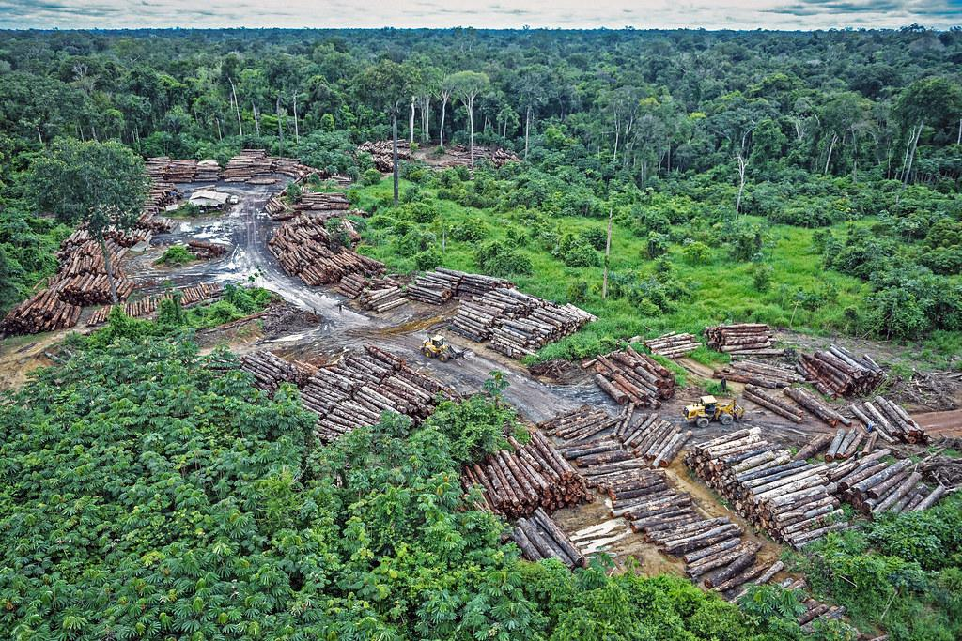
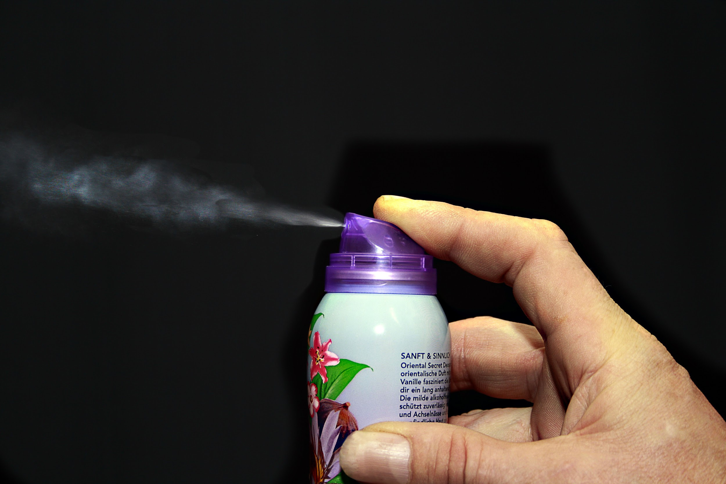
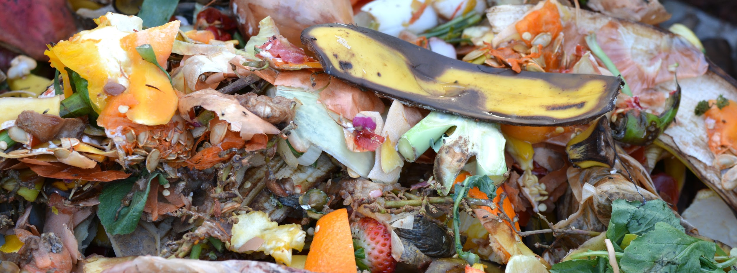
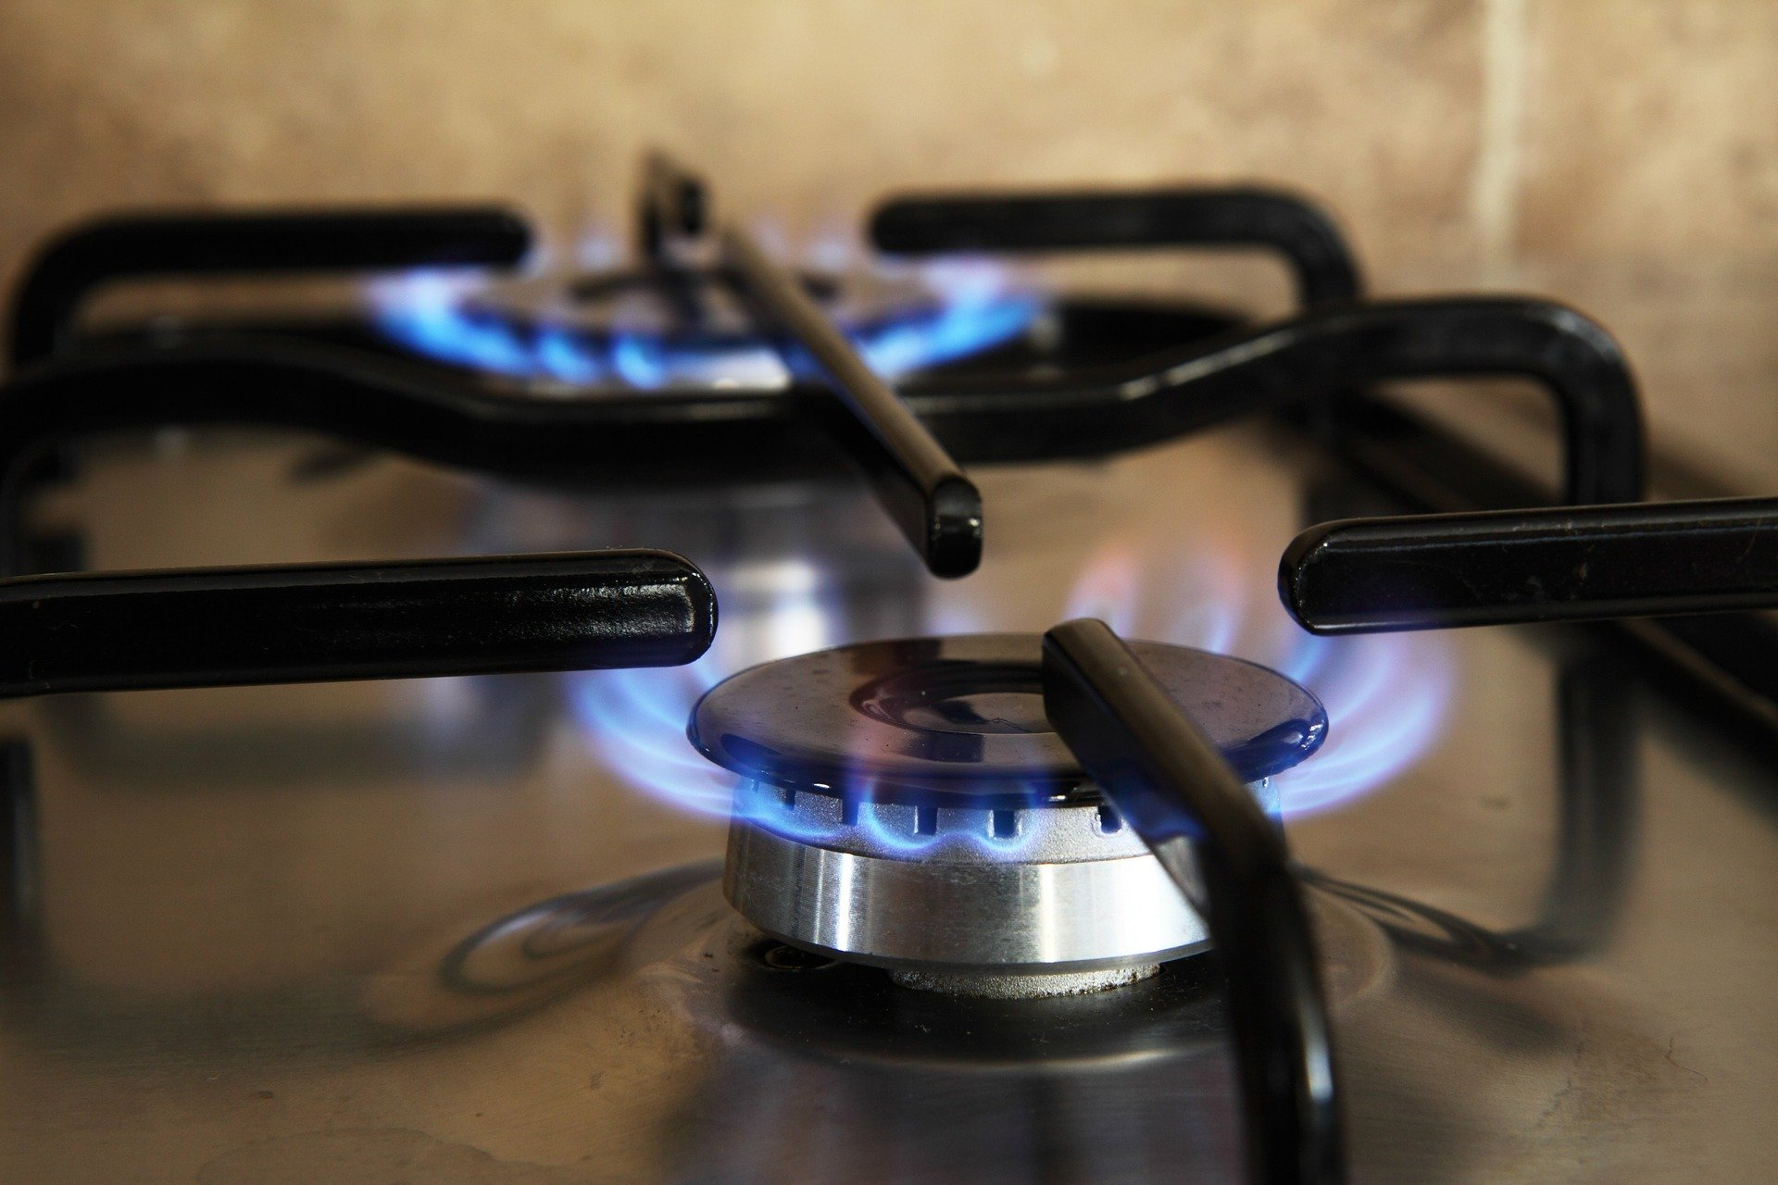
Activity: Which activity releases which greenhouse gas?
Carbon Dioxide
Methane
Nitrous Oxide
F Gases
Oil
Cement
Livestock
Refrigeration
Coal
Fertilisers
Deforestation
Aerosols
Organic Waste
Gas
Match the greenhouse gases with their sources.
Notes:
Match the greenhouse gases with their main sources.
Go through each GHG individually starting with Carbon Dioxide
(Let learners know that these are only the main GHGs that each source produces.
Each source may also produce other GHGs but in smaller quantities)
Ask learners to write into the chat box which sources produce Carbon Dioxide
Click to reveal the sources
Carbon Dioxide (CO₂)
Oil, coal and gas (fossil fuels).
Manufacture of cement
Deforestation
Ask learners to write into the chat box which sources produce Methane
Click to reveal the sources.
Methane (CH₄)
Decay of organic waste in landfills
Livestock
Ask learners to write into the chat box which sources produce Nitrous Oxide
Click to reveal the sources.
Nitrous oxide (NO₂)
Synthetic fertilisers
Ask learners to write into the chat box - Which of the remaining two sources produces the most F Gases
Click to reveal the sources.
F-gases (fluorinated gases)
Refrigeration - 79% of F Gases
Aerosols - 5% of F Gases
Images: See copyrighting document for image licenses
Figure 12: Burning of Oil
Figure 13: Cement Production
Figure 14: Livestock
Figure 15: Refrigerator Gas
Figure 16: Burning of Coal
Figure 17: Crop Fertiliser
Figure 18: Deforestation
Figure 19: Aerosols
Figure 20: Decay of organic waste
Figure 21: Burning of Gas

Slide 21
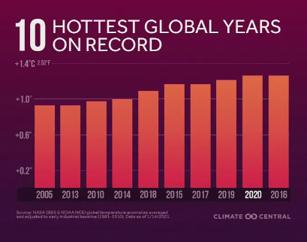
Summary of Climate Science
Emissions of greenhouse gases have risen since the industrial revolution
These emissions have enhanced the greenhouse effect leading to rising average global temperatures
As a result the 10 hottest global years on record have all occurred within the last 15 years
The average global temperature in 2020 was about 1.2°C (± 0.1) above the pre-industrial (1850-1900) level (WMO, 2021)
Notes:
WMO https://public.wmo.int/en/media/press-release/2020-was-one-of-three-warmest-years-record
Diagram: https://medialibrary.climatecentral.org/resources/2020-in-review-global-temperature-rankings

Slide 22
5-minute break time!
Photo credit: Rumman Amin (Unsplash.com)

Slide 23
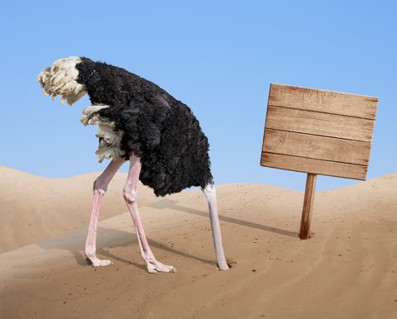
Climate change action and inaction

Slide 24
What is behind inaction?
Political preference
It’s too complicated
It’s too late!
Fake news
Confusing science
Time constraints
‘They’ will fix it
Financial constraints
I'm not sure how to act
It doesn’t match my world view
It’s not my responsibility
I’m just one person
Notes:
For this section, open up a poll for people to vote on the most significant thoughts behind inaction on climate change:
Poll options:
1.) ‘It’s someone else’s job to address climate change’
2.) ‘I’m just one person, I can’t make a difference’
3.) ‘I don’t have the time or money to address climate change’
4.) ‘Information about climate change is confusing’
5.) ‘It’s too late, so why try?’

Slide 25
‘But I’m only one person, I can’t make a difference’

Slide 26
Your own carbon footprint
Please work through the WWF carbon footprint calculator and reflect on your results.
https://footprint.wwf.org.uk/

Slide 27
Group discussion of carbon footprint results
If you are happy to share your results, feel free to pop them in the chat box.
Was your footprint larger or smaller than you expected?
Was there any result that surprised you?
Has this prompted you to make any immediate changes?

Slide 28
Your assessment form
Please open your assessment/evidence form.
From our activities today make a note of all the solutions you might include to answer Q2. Don’t worry, we will be coming back to this in later sessions.
https://ucw.onlinesurveys.ac.uk/carbon-literacy-assessment-form-4

Slide 29
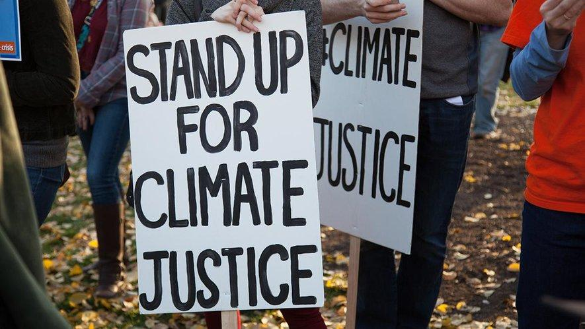
Next session we will:
Examine the impacts of climate change
Explore the distribution of impacts and reflect on climate justice
Consider possible future scenarios
If you have any questions about the course, you can contact Jess at j.tasney@worc.ac.uk.

Slide 30
Extra activity
If you would like to learn more before the next session, watch this video:
https://www.youtube.com/watch?app=desktop&v=EOctIuyVfnA
In the video, there is a discussion about communities that emit the least carbon emissions also being those that are most likely to suffer the most severe impacts of climate change.
Can you list two countries that you think will be most impacted by climate change?
Can you list two countries that you think will be least impacted by climate change?
What does this reveal to you?

