Slide 1
Session 1: Introduction to Carbon Literacy and the Science of Climate Change
Adapted for the University of Worcester by Katy Boom, Sian Evans, Gill Slater
Notes:
Delivery: KB
Before you begin:
- Have all video links open so these are ready to add to chat box
- Open WWF calculator
You will need one breakout room
Before you begin:
Have all video links open so these are ready
https://www.bbc.co.uk/news/av/world-57868135
https://www.youtube.com/watch?v=E8Y6L5TI_94
https://www.youtube.com/watch?v=2h0WxP3jJPU
Open WWF calculator My Footprint: Climate & Nature
https://www.carbonmap.org/#intro
https://www.bbc.co.uk/news/av/science-environment-58677993
https://susthingsout.com/carbon-literacy-training/
Welcome to the first of four carbon literacy training sessions.
The teaching style on this training combines the use of films, activities, and discussion workshops, it is highly participative, and we welcome you to ask questions and share your views at regular points throughout the sessions. Teaching Team of 4. We take it in turns.

Slide 2
What is Carbon Literacy?
An awareness of the carbon dioxide costs and impacts of everyday activities and the ability and motivation to reduce emissions on an individual, community and organisational basis.
The focus of this course is to empower you to choose your own climate solutions.
To be awarded certification, you must complete eight hours of training and pass a short assessment to the required standard.
Notes:
Delivery: KB
So, what exactly is Carbon Literacy? Read the slide.
The focus of this course is to empower you to choose your own climate solutions. To be awarded a certificate you must complete EIGHT HOURS of training and pass an assessment to the required standard. Please be assured that you will be given full instructions and guidance with this during the four sessions.
TIMECHECK: 10 MINS

Slide 3
Certification
To apply for certification from the Carbon Literacy Project, you need to attend all three sessions (6 hours) and complete the assessment form.
More information about the assessment form will be provided throughout the sessions.
If you have any question regarding the training or assessment, please contact g.slater@worc.ac.uk
Notes:
Delivery: KB
If you wish to apply for a CL certificate, you will need to attend all four sessions and complete the assessment form.

Slide 4
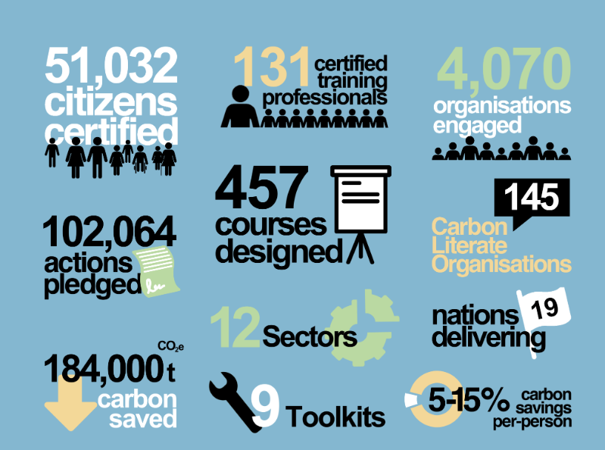
Carbon Literacy Project
Notes:
Delivery: KB
The Carbon Literacy Project to date has been extremely successful, as you can see from the achievements set out here.

Slide 5
During the training you will:
 | Session 1 - Science | Session 2 - Impacts
The Problem | Learn about the science of climate change Your individual carbon footprint | Examine the impacts of climate change Explore the distribution of impacts and reflect on climate justice Consider possible future scenarios
 | Session 3 – Actions
The Solutions | Learn about action on climate change (including mitigation and adaptation) at various scales Compare high and low carbon footprint actions Devise high impact individual strategies Consider ‘multisolving’ climate solutions Devise high impact group strategies
“Providing you with the tools to make a difference….”
Notes:
Delivery: KB
During the four sessions you will consider first the problem and then the solutions. These will be broken down in the following way – explain.

Slide 6
Session one: learning outcomes
Introduction to the training
Introduction to the basics of climate science
Calculating your individual / household carbon footprint
Independent learning task
Notes:
Delivery: KB

Slide 7
Introduction
This is an introductory video from July last year highlighting the immediacy of the climate emergency and the need for urgent action, the content of which will be built on further today and during other sessions.
Watch the video and consider your response. After the video, we will discuss in breakout rooms.
Notes:
Delivery: KB
Link to video: https://www.bbc.co.uk/news/av/world-57868135
Duration of video: 7:26
ACTION: add video link to the chat – learners should watch the video themselves (do not screenshare).

Slide 8
Activity: Getting to know you
a.) Introduce yourself to the group
b.) Give one reason why you are attending the training
c.) Highlight one thing from the video that stood out for you
Notes:
Delivery: KB
ACTION: put participants into breakout rooms of 6/7 for 12 mins.
Remind participants that if they finish early, they can rejoin us in the main room.
Participants to feed back to the main group (5 mins).

Slide 9
What are the predicted impacts for UK?
Hotter, drier summers
What's the issue?
Droughts and heatwaves
Water security
Health impacts on young and elderly citizens
Invasive species e.g. mosquitoes
Unstable food prices
Wetter, stormier, warmer winters
What's the issue?
Wet winters could become up to x5 more likely
More frequent intense downpours driving flash floods
North of England and Scottish Borders are most impacted
2013-2014: we suffered the wettest winter for 250 years – 11,000 homes were flooded
Notes:
Delivery: KB
Additional resources :
https://www.metoffice.gov.uk/research/climate/understanding-climate/uk-extreme-events-_heavy-rainfall-and-floods
For UK specific overview see: https://www.youtube.com/watch?v=1k-5_WKUtBM&t=10s

Slide 10
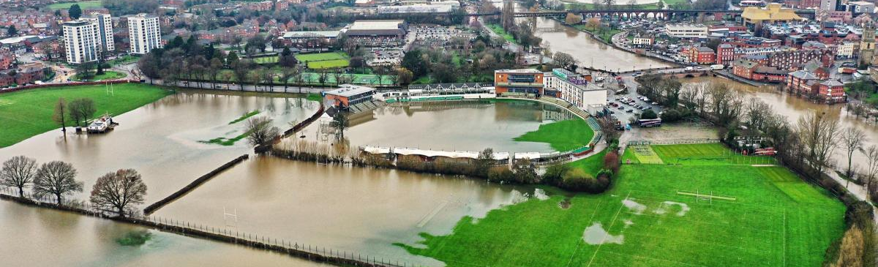
What is happening locally?
Notes:
Delivery: KB
What is happening locally?
ACTION: ask learners if they can identify the location in the image on the slide
We saw from introductory video that the earth’s climate has changed and some of the global impacts.
Climate change is affecting us all, use the chat to give some local examples.
ACTION: give people a moment to add to chat and then discuss
TIMECHECK: 55 mins

Slide 11
The carbon cycle
Notes:
Delivery: SE
We’re now going to explore some of the science about what, why and how this is happening.
Link to video: https://www.youtube.com/watch?v=E8Y6L5TI_94
Video lasts for 1.46 very short video.
ACTION: add video link to the chat – learners should watch the video themselves (do not screenshare).

Slide 12
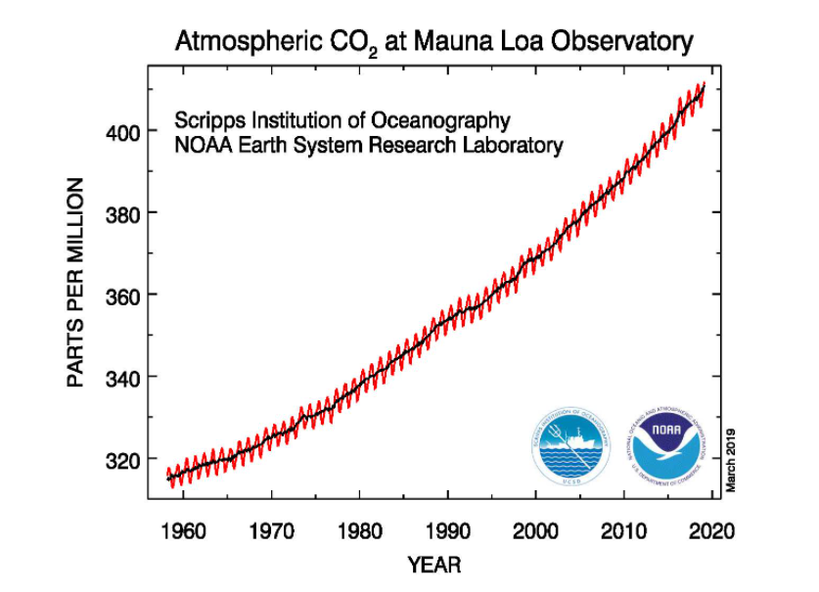
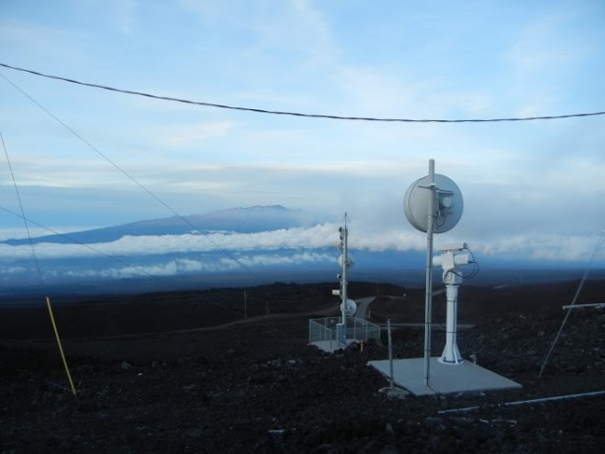
CO₂ levels are rising
Notes:
Delivery: SE
So let’s look at some of the evidence supporting this change in the carbon cycle. Scientifically rigorous measurement of carbon dioxide began at a weather station on Mauna Loa in 1958. The NOAA began measurements in 1974, both have made complementary independent observations since. The graph shows how since measurements began atmospheric CO2 has continued to rise on an annual basis.
But how does this compare to historic levels of CO2?
Source: https://gml.noaa.gov/ccgg/trends/mlo.html

Slide 13
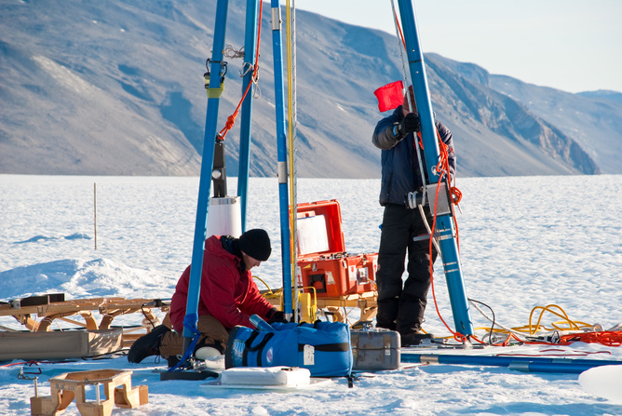
What do ice cores measure?
Ice cores reveal historic levels of CO₂
Notes:
Delivery: SE
Through the use of proxy data we can explore how CO2 has changed over a much greater time period. Ice cores are one example of a proxy measure. Deep cores of ice are extracted in remote locations such as the Antarctic and gases trapped in tiny air bubbles within these cores are measured and dated. This can be used to give us a comprehensive understanding of how much CO2 was in the atmosphere hundreds of thousands of years ago.
Other proxy measures can tell us more about climates in particular locations, these include pollen analysis from peat cores and ocean / river sediments which can be used to identify past vegetation (and hence past climates) and tree rings.

Slide 14
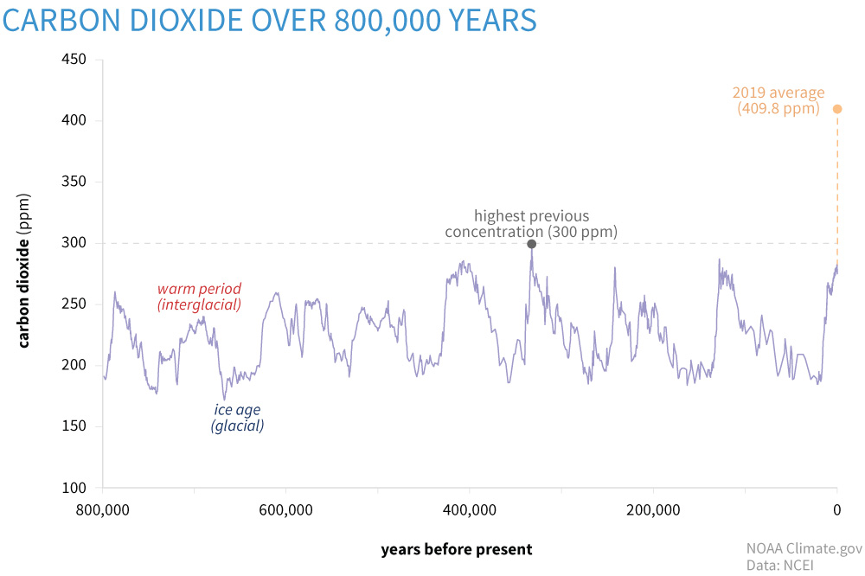
2021 average: 416.45 ppm
Notes:
Delivery: SE
This graph has been put together using such proxy measures to show how CO2 levels have changed over the past 800,000 years. The highest historic CO2 level was 400,000 years ago when it peaked at 300ppm. As you can see this has risen significantly with the 2020 annual average at 413.94ppm
Source: https://www.climate.gov/news-features/understanding-climate/climate-change-atmospheric-carbon-dioxide

Slide 15
Natural v anthropogenic (man-made) climate change
The causes of climate change can be considered in two broad categories: natural causes and anthropogenic causes.
Natural causes refer to natural phenomena that are not related to human activity which cause climate change, including volcanic and solar activity
Anthropogenic causes refer to human activities that cause climate change
Notes:
Delivery: SE
Climate change has occurred naturally since the very beginnings of our planet and historically we have seen several climate change event, including the Ice age. In the historic past climate change was only caused by natural changes or events, such as volcanic and solar activity, however since humans industrialised, we have released, and continue to release huge amounts of greenhouse gases that cause climate change into the atmosphere.

Slide 16
Natural or anthropogenic?
Changes to Earth’s orbit
Burning gas to generate energy
Intensive agriculture
Deforestation
Using aerosols
Solar flares
Causes of climate change
Driving petrol/ diesel vehicles
The aviation industry
Sending waste to landfill
Volcanic eruptions
Notes:
Delivery: SE
Take a look at the different causes of climate change. On this slide there are ten causes, both natural and anthropogenic. Ask delegates to add to the chat how many of these are natural sources of climate change.
ACTION: click to reveal three natural sources
Of the remaining seven man-made sources of climate change, ask delegates to think about which of these causes might have the most significant impact and whether any of them are causes you can address in your daily life?
TIMECHECK: 1HR 5MINS

Slide 17
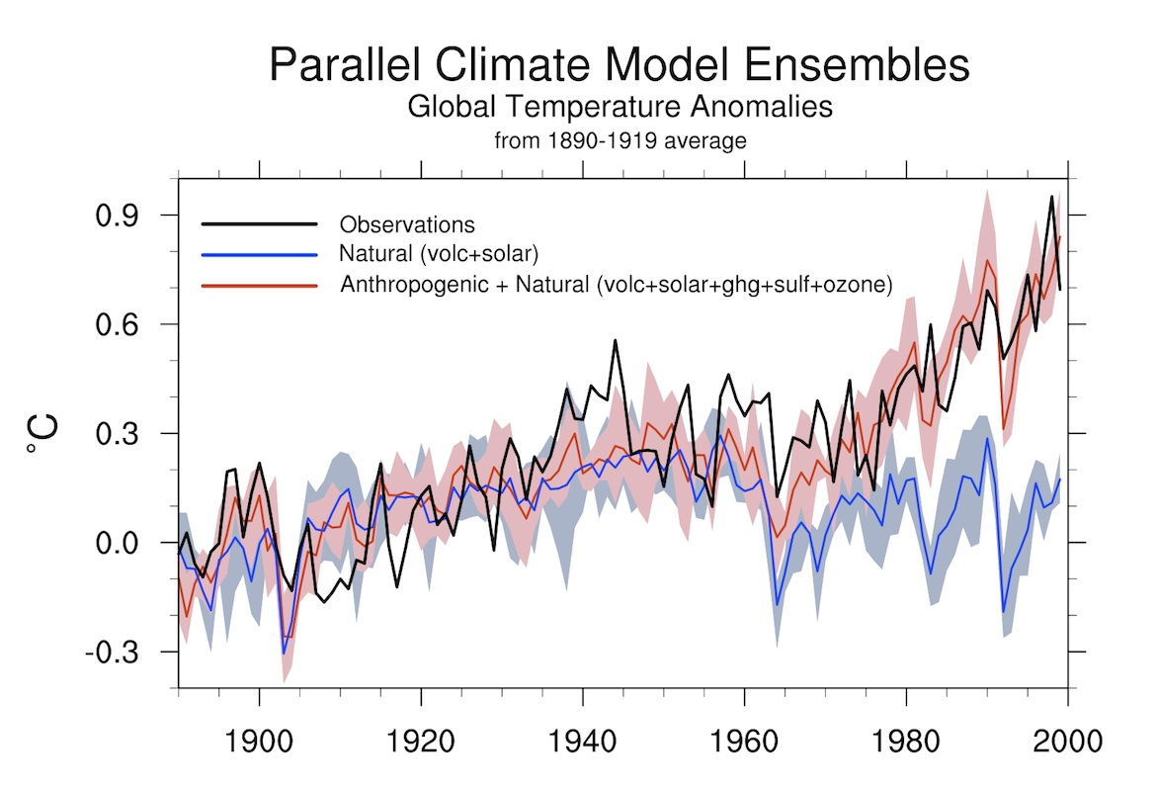
Anthropogenic climate change
In 2021, the Intergovernmental Panel on Climate Change said:
It is “unequivocal that human influence has warmed the atmosphere, ocean and land”.
Notes:
Delivery: SE
It is now deemed absolutely unequivocal that human activities have caused the atmosphere, ocean and land to warm.
Explain graph – when modelling changes in global temperatures over time, these can only be explained when anthropogenic forces are included.
Source: http://ossfoundation.us/projects/environment/global-warming/myths/images/models/Mheel_Attribution-72-1200w.jpg/image_view_fullscreen

Slide 18
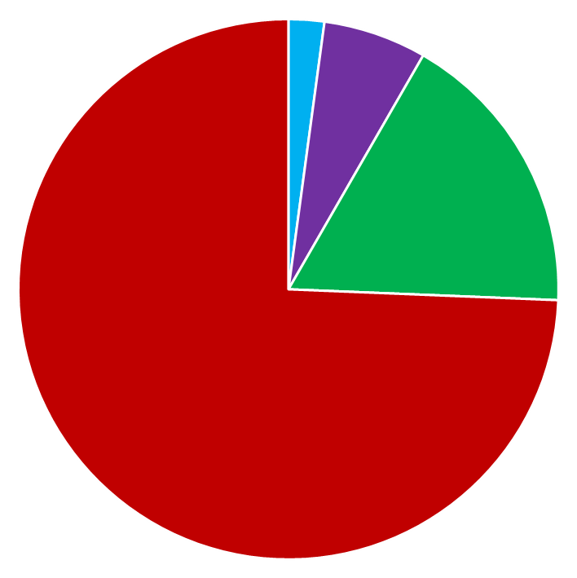
Greenhouse Gas Emissions by gas
Carbon Dioxide
Methane
Nitrous Oxide
F-gases
F-gases
1,054 MtCO₂e
(2%)
Carbon Dioxide accounts for 74% of total Greenhouse Gas Emissions
N₂O
3,054 MtCO₂e
(6%)
CO₂
36,700 MtCO₂e
(74%)
CH₄
8,550 MtCO₂e
(17%)
Notes:
Delivery: SE
We'll now explore the key greenhouse gases in more detail. The main greenhouse gases are carbon dioxide, methane, nitrous oxide and the fluorinated or F-gases.
The most widely known and most abundant greenhouse gas is Carbon Dioxide or CO2, which accounts for 74% of total greenhouse gas emissions. As you can see on the pie-chart, this equates to the emission of 36,700 Mega-tonnes of carbon dioxide equivalent per year. There are multiple sources of carbon dioxide, some natural and others arising as a result of human activities. The release of carbon dioxide from fossil fuel combustion: the burning of coal and oil and gas is by far the most significant human source of CO2. Carbon dioxide is also produced in substantial quantities during cement production in the process of making clinker which is a main ingredient of cement. In both fossil fuel and cement production we are releasing carbon into the atmosphere that has been locked up for millions of years in geological reservoirs (be that limestone rocks, or coal seams, or oil and gas fields). Carbon dioxide is also released into the atmosphere as a result of deforestation and land use changes such as draining peatlands and wetlands. Plants and soils store carbon that was fixed from the atmosphere by plants during photosynthesis. When we cut down forests and degrade soils, this carbon is released back to the atmosphere. Sadly this is getting more significant as time goes on because global deforestation rates are increasing.
The second most abundant greenhouse gas is Methane or CH4, which accounts for 17% of total greenhouse gas emissions. This equates to 8,550 Mega-tonnes of carbon dioxide equivalent per year. Again there are multiple sources of methane, both natural and anthropogenic. Around a third of methane emissions arise during the extraction of fossil fuels and leakage during transport by pipeline or other methods such as shipping - where this is referred to as fugitive (or escaping) emissions. A very small amount of methane is also released during fossil fuel combustion (only 4%). Collectively, the main source of anthropogenic methane is agriculture, which accounts for around 42% of global emissions and is dominated by livestock production – and specifically ruminant animals. A ruminant is any animal that chews the cud – so cattle, sheep, goats, deer, and camels are all ruminants. Methane is produced whenever biomass is broken down under low oxygen conditions. So if we look at our other agricultural sources of methane…In manure management - anaerobic conditions often occur where manure is stored in large piles or settlement ponds – so the microbes breaking down the manure will produce methane. Likewise, in rice paddies – the waterlogged soils are anaerobic – so the microbes in paddy field soils will produce methane. We also see the same microbial processes happening in the management of human wastes – in both landfilling and in wastewater treatment, where anaerobic breakdown of organic matter accounts for around 18% of global methane emissions. The last source of methane is biomass burning – which accounts for around 3% of emissions.
The third most abundant greenhouse gas is Nitrous Oxide or N2O, which accounts for 6% of total greenhouse gas emissions and equates to 3.054 Mega-tonnes of carbon dioxide equivalent per year, and again has natural and human sources. As with methane, fossil fuel combustion will result in some emissions of nitrous oxide – again these emissions are relatively small compared to the amount of carbon dioxide released – although they do account for around 10% of nitrous oxide emissions. Indeed, any combustion process will result in some nitrous oxide emissions, and so biomass burning is also a source of nitrous oxide – accounting for around 11% of global N2O emissions. Similarly to methane, agriculture is our main source of nitrous oxide – accounting for around two-thirds (or 66%) of total N2O emissions. This is dominated by the use of nitrogen based fertilisers and applying manure (a nitrogen rich material) to soils, with some additional emissions from manure management. Here, the nitrogen in the fertiliser or the muck stimulates the microbial nitrogen cycle to produce nitrous oxide. Human sewage is also a nitrogen rich material – and so wastewater management also produces nitrous oxide. In addition to fossil fuel combustion there are other industrial sources of nitrous oxide. The two most significant are adipic and nitric acid production – which account for around 5% of global nitrous oxide emissions. Adipic acid is used in the manufacture of synthetic fibres like nylon. Nitric acid is used in a number of processes, including the manufacture of N based fertilisers and explosives.
The final greenhouse gases are grouped together under the heading of F-gases, they account for only 2% of total greenhouse gas emissions which equates to 1,054 Mega-tonnes of carbon dioxide equivalent per year. These are human-made chemicals so their sources are entirely industrial, and their emissions are associated with a wide range of different applications and processes. Many of them were produced as replacements for the chlorofluorocarbons – or CFCs – when they were banned under the Montreal Protocol on Ozone Depleting Substances.
HFCs – the hydrofluorocarbons - are used as aerosol propellants, as refrigeration gases in fridges, freezers and air conditioning systems, and as fire-fighting agents.
PFCs – the perfluorocarbons – are produced during primary (or new) aluminium smelting, where you don’t get these emissions from secondary (recycled) aluminium.
PFCs are also used as etching gases and cleaning agents in semiconductor manufacture.
Finally, the F-gas sulphur hexafluoride, is used as an electrical insulator to prevent arcing and electrical fires in high voltage gas insulated switchgear like electricity substations).
Does anyone have any questions about these gases?
Credit MMU
Data Source: The data presented in the pie-chart here is the 2016 Global (World) emissions (including Land Use Change and excluding Bunker Fuels) from the World Resources Institute CAIT Climate Data Explorer – Historical Emissions – Country GHG Emissions dataset:
http://cait.wri.org/historic
The % of global anthropogenic CH4 emissions in these notes are from this open access paper: Wang, W., Ren, J., Li, X., Li, H., Li, D., Li, H., & Song, Y. (2020). ‘Enrichment experiment of ventilation air methane (0.5%) by the mechanical tower.’ Scientific Reports, 10, 7276 (11pp). https://doi.org/10.1038/s41598-020-63698-x
The % of global anthropogenic N2O emissions in these notes are from the following open access paper and report:
Davidson, E.A., Kanter, D. (2014). ‘Inventories and scenarios of nitrous oxide emissions.’ Environmental Research Letters, 9(10), 105012 (12pp). https://doi.org/10.1088/1748-9326/9/10/105012
UNEP (2013). Drawing Down N2O to Protect Climate and the Ozone Layer: A UNEP Synthesis Report. https://wedocs.unep.org/handle/20.500.11822/8489
EXPANDED GHG Sources Activity Feedback 4/4 – F gases (ANIMATED SLIDE)

Slide 19
Global Warming Potentials and CO2e
Carbon Dioxide (CO₂)
Methane (CH₄)
Nitrous Oxide (N₂O)
F Gases (various)
1
28
273
10s to 10,000s
Global warming potentials
CO2e
Notes:
Delivery: SE
Not all GHGs are equal – some are more potent than others. That is, their contribution to global heating changes depending on their ability to radiate and absorb energy – this difference is called their 'global warming potential'. This is a measure of the gases ability to trap heat in the atmosphere compared to carbon dioxide on a weight for weight basis. So for example, if we look at methane, it has a global warming potential of 28. This tells us that emitting 1 tonne of methane has the same effect as emitting 28 tonnes of carbon dioxide (it is 28 times more potent as a greenhouse gas!).
The relative importance of these greenhouse gases to climate heating is also impacted by their lifetime (how long they stay in the atmosphere before decaying).
From this slide, you may be surprised to see that carbon dioxide has the lowest global warming potential. So why is this the gas that is of most concern to scientists and policy makers? It is because of the considerable increase in the amount of carbon dioxide that humans have added to the atmosphere from the industrial revolution onwards and the length of time it can stay in the atmosphere. The lifetime of CO2 in the air, is the most difficult to determine of all GHGs, because there are several processes that remove carbon dioxide from the atmosphere. Between 65 and 80% of CO2 released into the air dissolves into the ocean over a period of 20–200 years. The rest is removed by slower processes that take up to several hundreds of thousands of years, including chemical weathering and rock formation. This means that once in the atmosphere, carbon dioxide can continue to affect climate for thousands of years.
The volume of methane has also increased in recent years, as highlighted above methane is 28 times more potent than carbon dioxide, so a cause of increasing concern but it has a much shorter lifetime in the atmosphere of around 12 years. Thus although methane is a potent greenhouse gas, its effect is relatively short-lived.
As we already discussed, there is less Nitrous Oxide in the atmosphere than methane, however its global warming potential is significantly greater at 273 times that of Carbon Dioxide and it is destroyed in the stratosphere and removed from the atmosphere more slowly than methane, persisting for around 114 years.
The global warming potentials of the F-gases range from 10s to 10s of thousands of times more potent than carbon dioxide. F gases can last in the atmosphere for a specific length of time – from less than a year to many thousands of years.
For emissions of any greenhouse gas, we take the mass emitted, we multiply it by the appropriate global warming potential, and that gives us our emissions in the common currency of carbon dioxide equivalents – which is then what allows us to compare the relative size of emissions of different gases from different sources – like for example when we calculate our carbon footprint.
Sources:
https://www.epa.gov/ghgemissions/understanding-global-warming-potentials
https://www.theguardian.com/environment/2012/jan/16/greenhouse-gases-remain-air

Slide 20
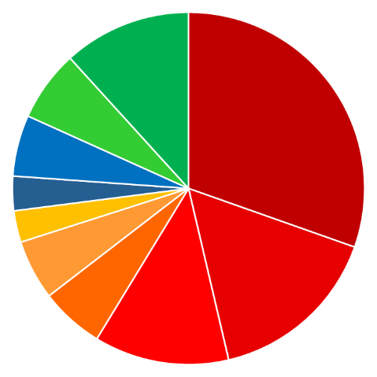
GHG emissions by sector
Agriculture
5,796 MtCO₂e (12%)
Energy accounts for 73%
of global GHG emissions
LUCF
3,217 MtCO₂e (7%)
Electricity & Heat
15,005 MtCO₂e (30%)
Industrial Processes
2,771 MtCO₂e (6%)
Waste
1,561 MtCO₂e (3%)
Other Fuel
1,429 MtCO₂e (3%)
Buildings
2,721 MtCO₂e (6%)
Fugitive
2,883 MtCO₂e (6%)
Transportation
7,866 MtCO₂e (16%)
Manufacturing
& Construction
6,109 MtCO₂e (12%)
Notes:
Delivery: SE
So now we’ve reviewed the different gases and their sources, let’s have a look at our overall emissions.
This pie chart shows a breakdown of global emissions by sector – it includes all the greenhouse gases with emissions expressed in Mega tonnes (that’s millions of tonnes) of carbon dioxide equivalents per year.
All the “hot” colours (yellow-red) represent energy related emissions – so we can see our use of energy accounts for nearly three-quarters of global GHG emissions.
Data Source: The data presented here is the 2016 Global (World) emissions (including Land Use Change and excluding Bunker Fuels) from the World Resources Institute CAIT Climate Data Explorer – Historical Emissions – Country GHG Emissions dataset:
http://cait.wri.org/historic
Credit MMU

Slide 21
GHG emissions by sector & gas
Industrial
Processes
2,771 MtCO₂e
(6%)
Energy
36,014 MtCO₂e
(73%)
LUCF
3,217 MtCO₂e
(7%)
Agriculture
5,796 MtCO₂e
(12%)
Waste
1,561 MtCO₂e
(3%)
carbon dioxide
methane
nitrous oxide
F-gases
Notes:
Delivery: SE
To summarise all of this information, this slides provides a breakdown by both sector and gas where the area of each pie-chart is scaled to reflect the total emissions from the different sectors. So we can see that “Energy” and “Land Use Change and Forestry” are dominated by carbon dioxide, with smaller amounts of methane and nitrous oxide. “Industry” is dominated by carbon dioxide, with significant emissions of F- gases and nitrous oxide, while “Agriculture” and “waste” (which includes both solid waste and wastewater management) are dominated by methane and nitrous oxide.
Data Source: The data presented here is the 2016 Global (World) emissions (including Land Use Change and excluding Bunker Fuels) from the World Resources Institute CAIT Climate Data Explorer – Historical Emissions – Country GHG Emissions dataset:
http://cait.wri.org/historic
Credit MMU

Slide 22
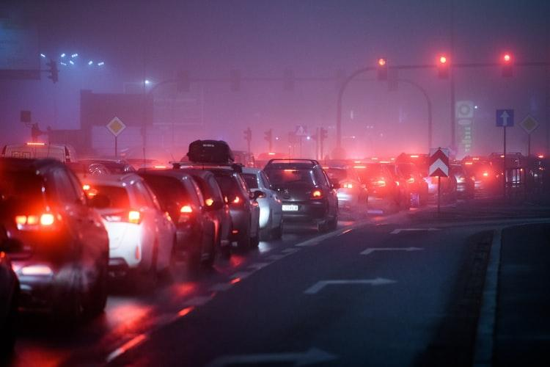
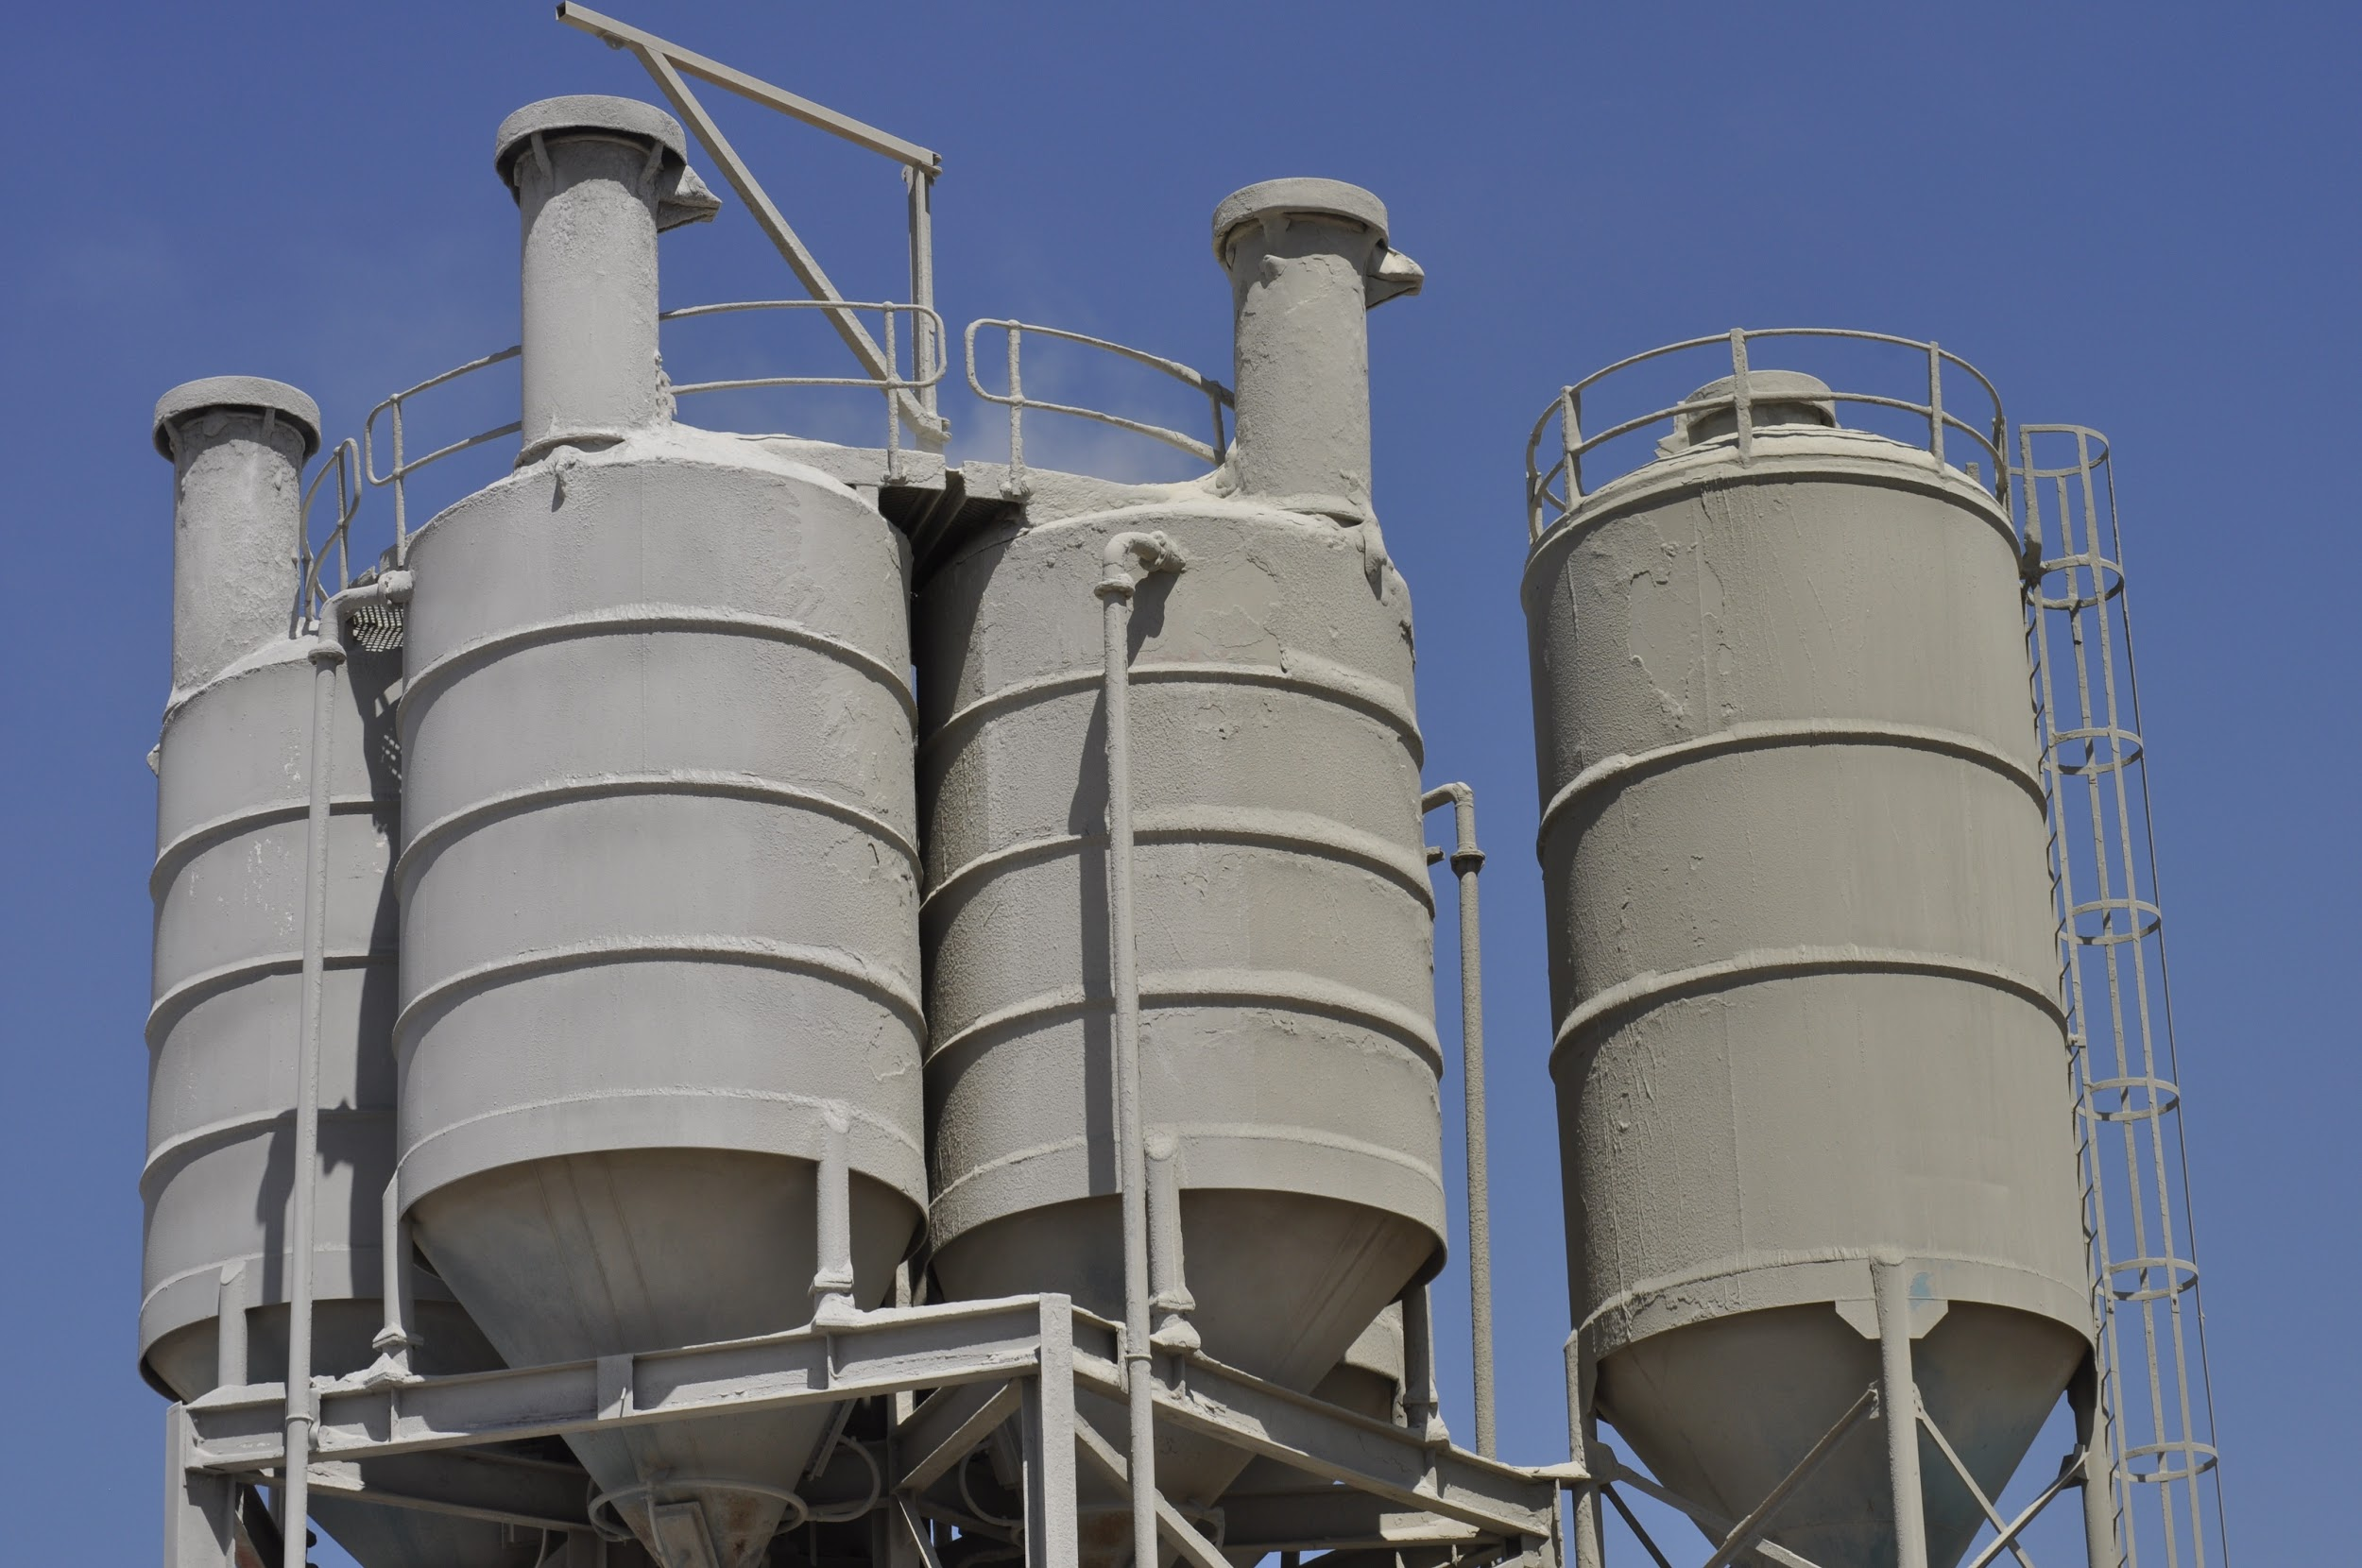
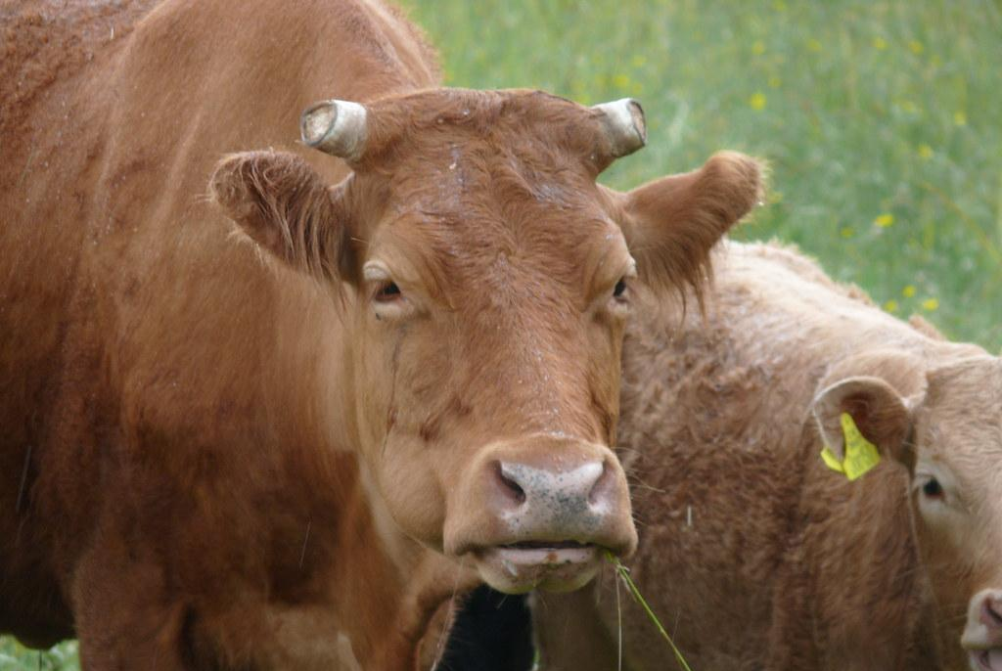
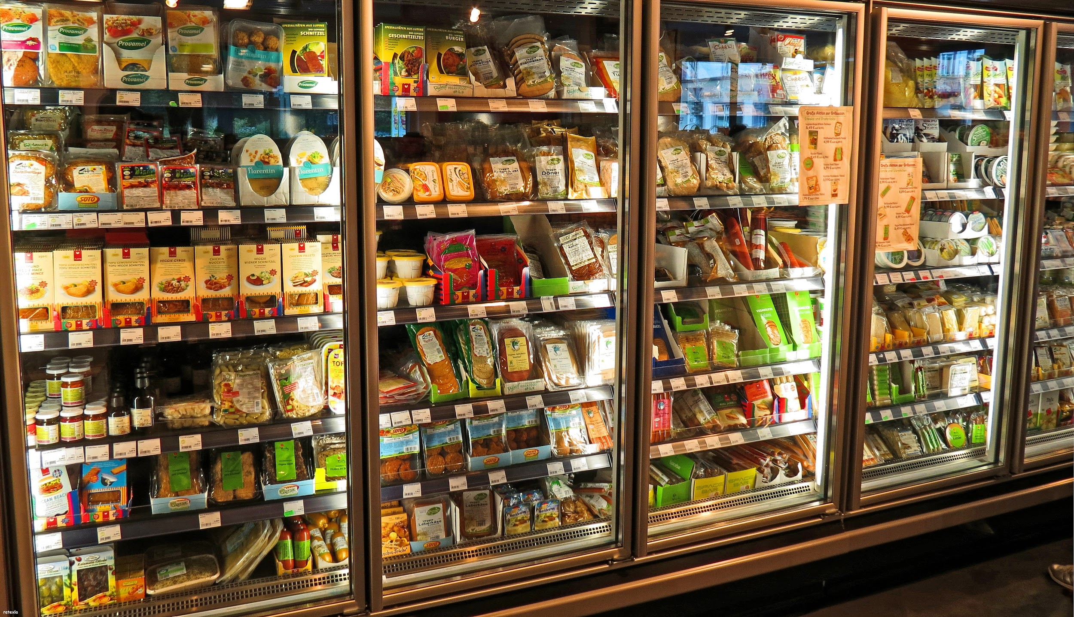
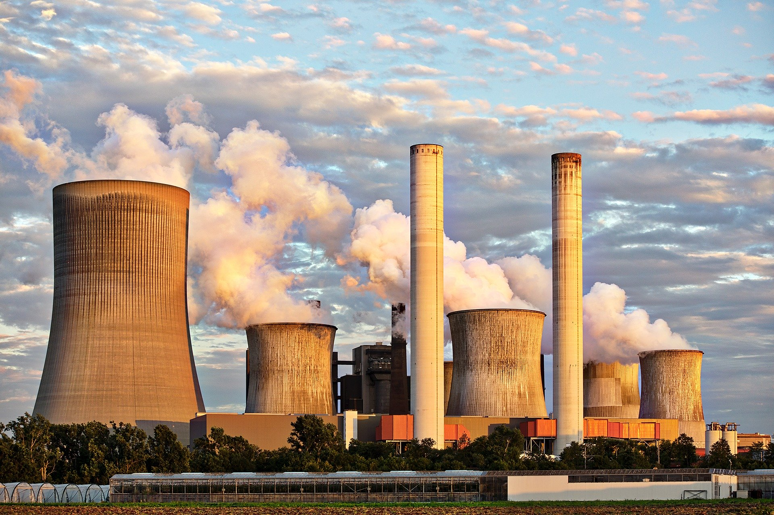
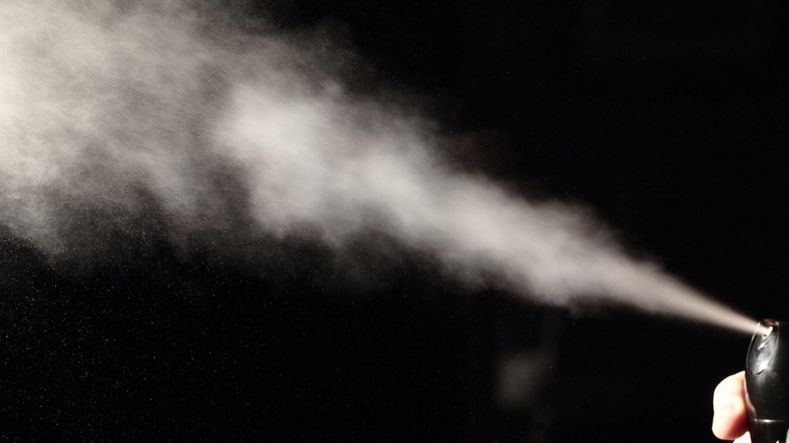
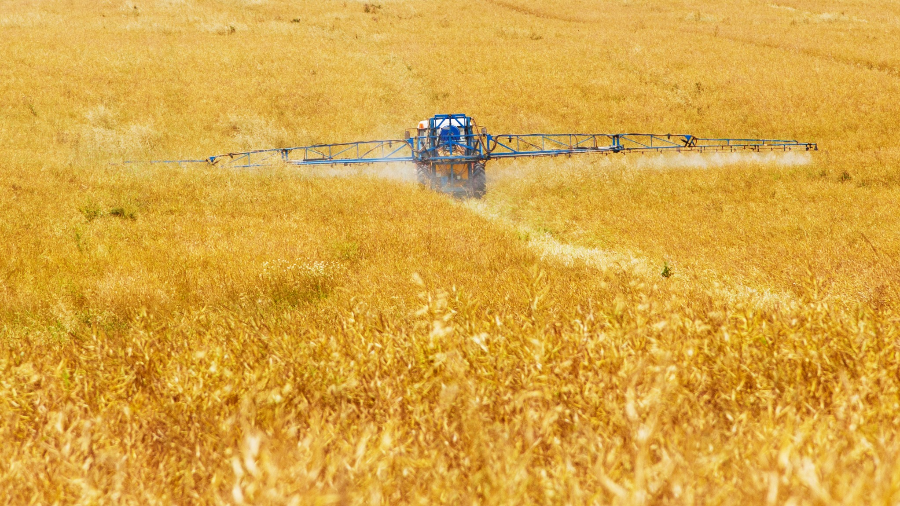
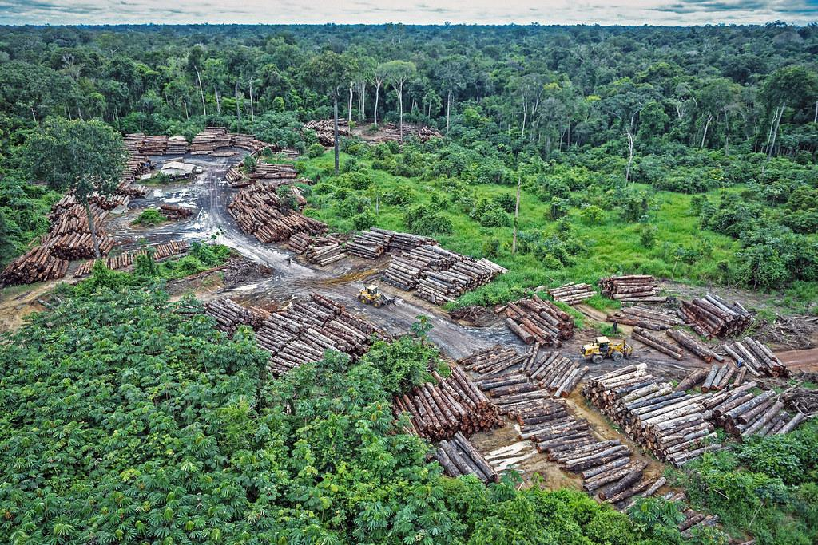
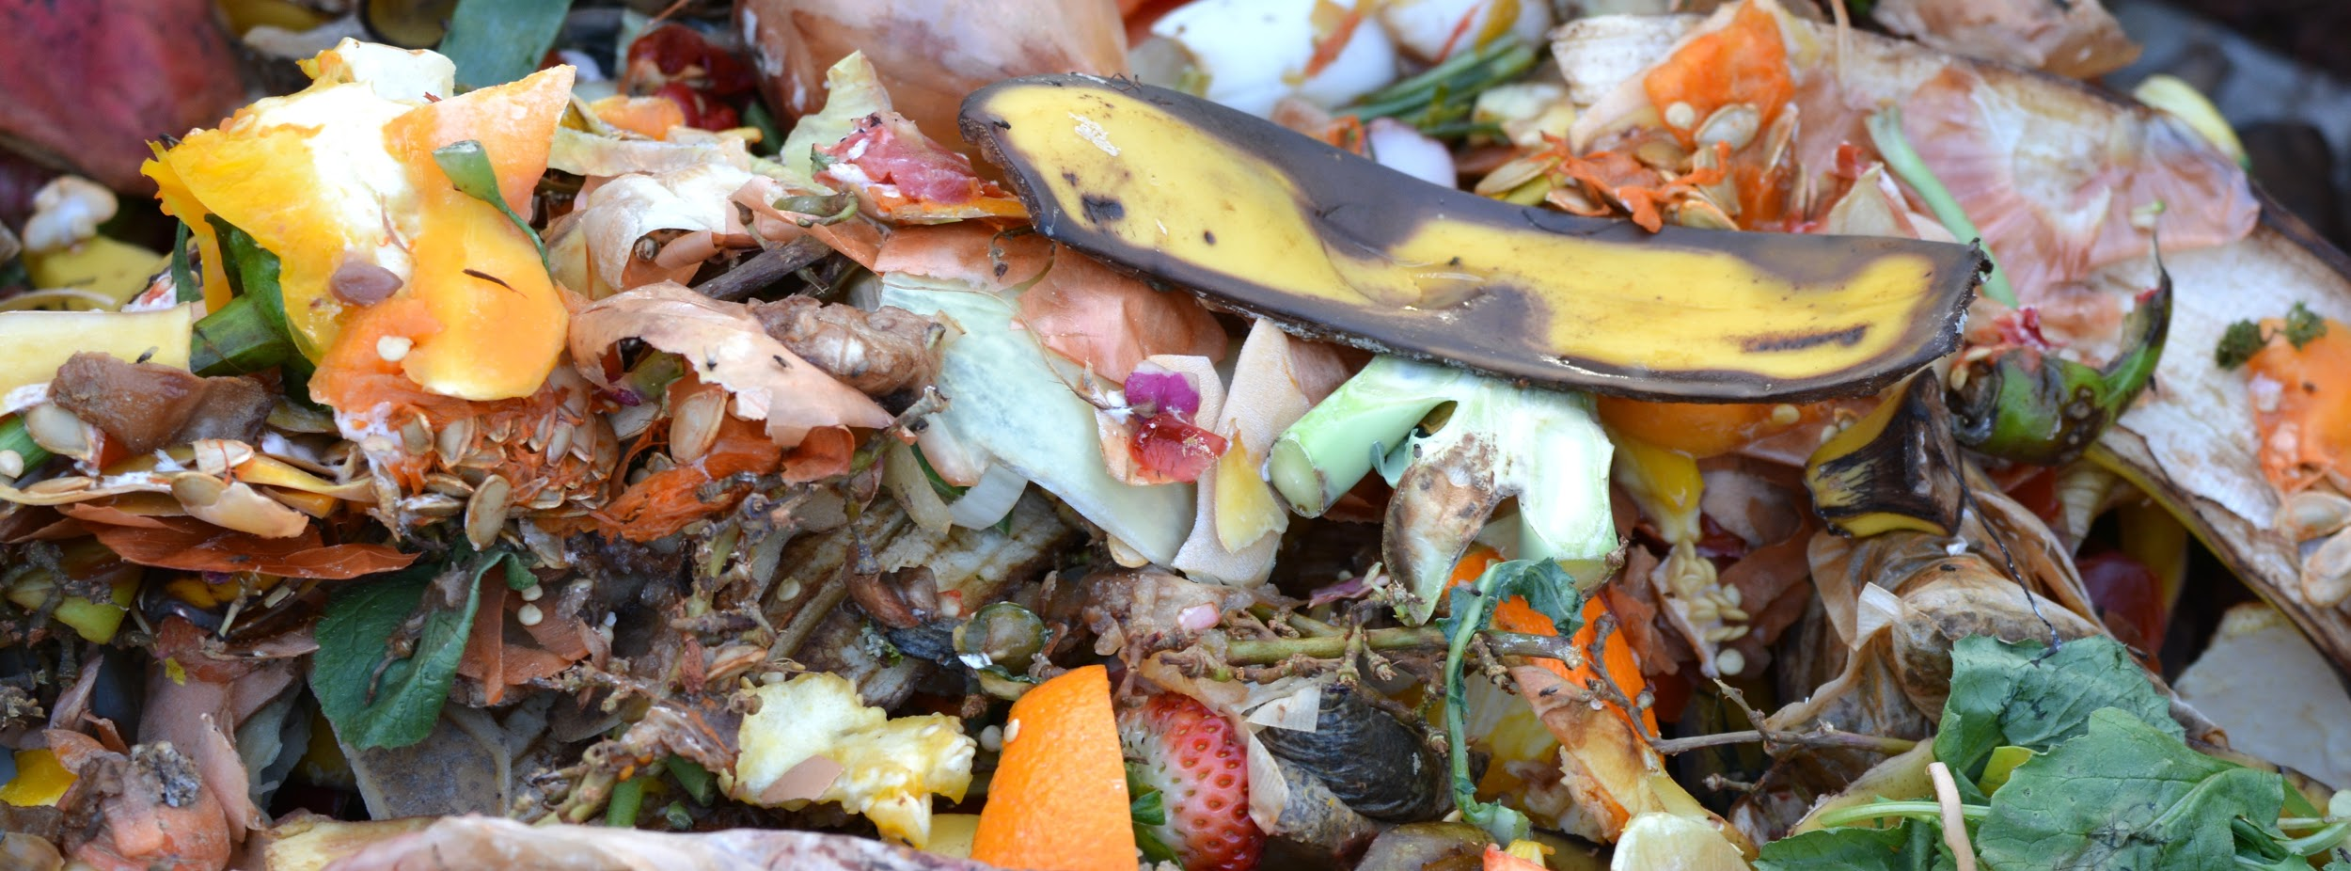
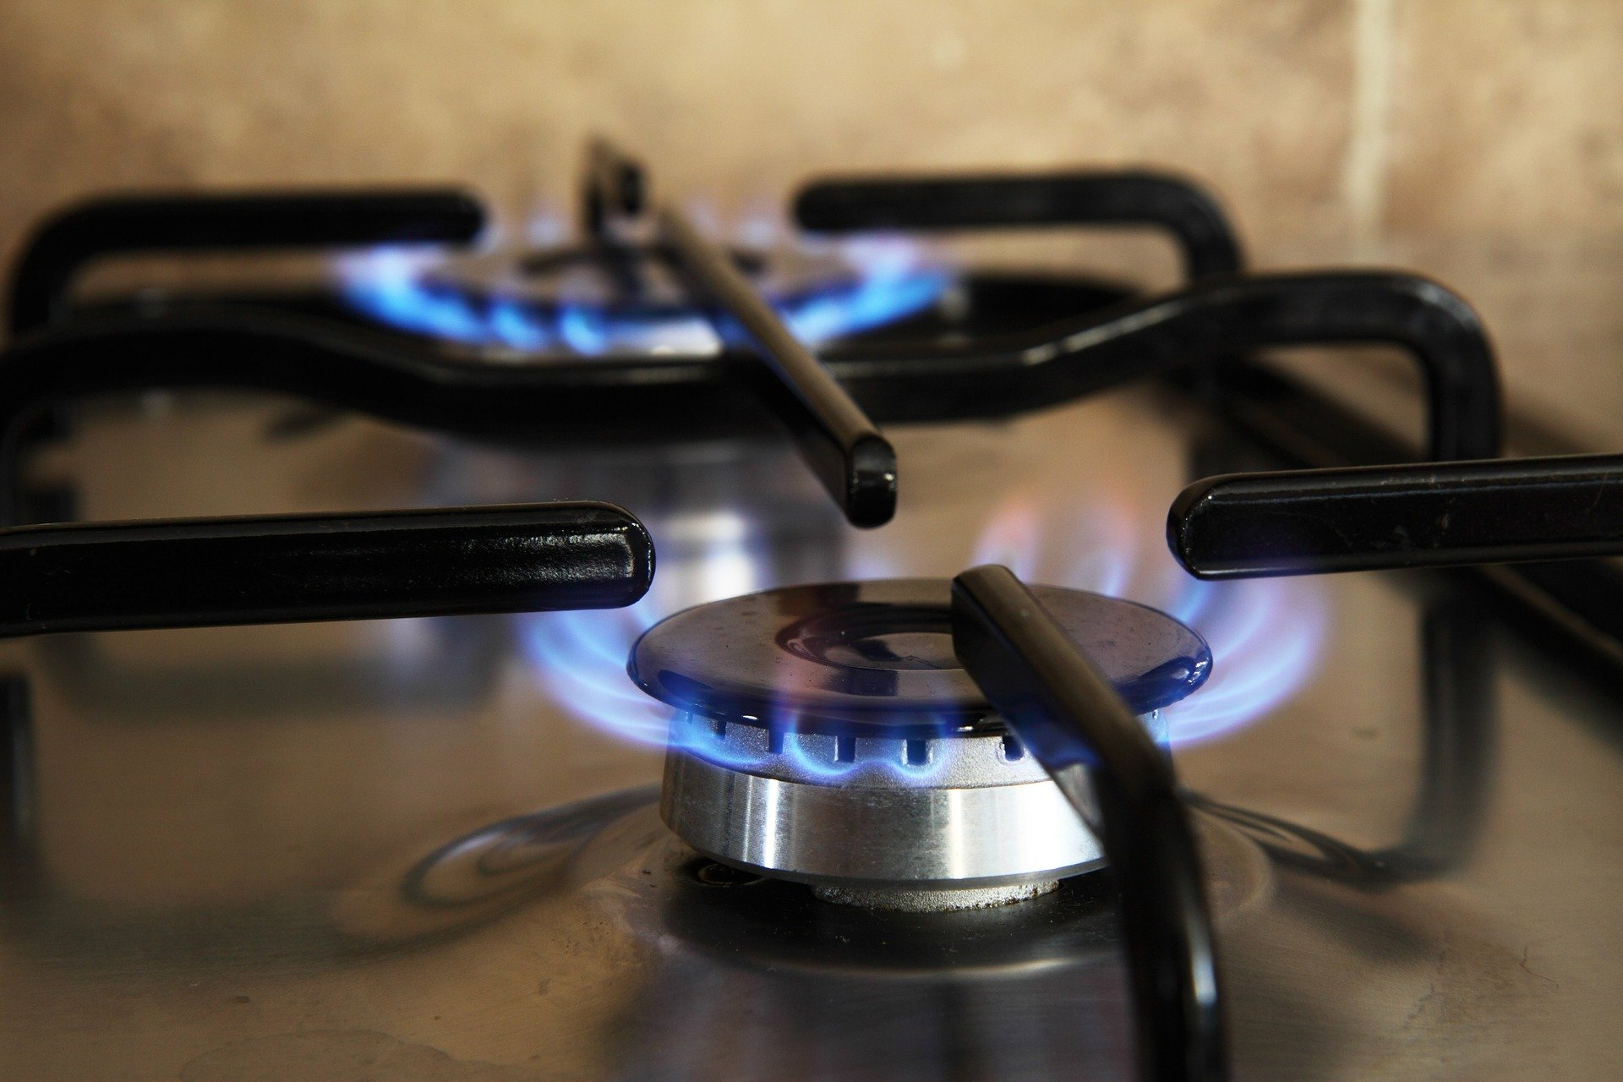
Activity: which activity releases which greenhouse gas?
Carbon Dioxide
Methane
Nitrous Oxide
F Gases
Oil
Cement
Livestock
Refrigeration
Coal
Fertilisers
Deforestation
Aerosols
Organic Waste
Gas
Match the greenhouse gases with their sources.
Notes:
Delivery: SE
Go through each GHG individually starting with Carbon Dioxide
(Let learners know that these are only the main GHGs that each source produces.
Each source may also produce other GHGs but in smaller quantities)
Ask learners to write into the chat box which sources produce Carbon Dioxide
Click to reveal the sources
Carbon Dioxide (CO₂)
Oil, coal and gas (fossil fuels).
Manufacture of cement
Deforestation
Ask learners to write into the chat box which sources produce Methane
Click to reveal the sources.
Methane (CH₄)
Decay of organic waste in landfills
Livestock
Ask learners to write into the chat box which sources produce Nitrous Oxide
Click to reveal the sources.
Nitrous oxide (NO₂)
Synthetic fertilisers
Ask learners to write into the chat box - Which of the remaining two sources produces the most F Gases
Click to reveal the sources.
F-gases (fluorinated gases)
Refrigeration - 79% of F Gases
Aerosols - 5% of F Gases
Images: See copyrighting document for image licenses
Figure 12: Burning of Oil
Figure 13: Cement Production
Figure 14: Livestock
Figure 15: Refrigerator Gas
Figure 16: Burning of Coal
Figure 17: Crop Fertiliser
Figure 18: Deforestation
Figure 19: Aerosols
Figure 20: Decay of organic waste
Figure 21: Burning of Gas

Slide 23
What about embodied carbon emissions?
Embodied carbon means all the CO2e emitted in producing goods and services from extraction to final disposal, or ‘cradle to grave’.
For example, the embodied carbon of a building can include all the emissions from:
Extracting, transporting and manufacturing construction materials
The building process and refurbishment
Deconstructing and final disposal of the building materials
Notes:
Delivery: SE
Link to video: https://www.youtube.com/watch?v=2h0WxP3jJPU
Duration of video: 2:19
We’ve looked at emissions directly associated with different activities, but when we think about greenhouse gas or CO2e emissions, we also need to think about something called ‘embodied carbon’ (read slide).
We often think about embodied carbon in terms of buildings, but we can also think about it for all goods and services e.g.,
The World Green Building Council has created a video explaining embodied emissions in the construction sector, and why embodied carbon needs just as much attention as operational carbon when it comes to reaching carbon reduction targets.
ACTION: add video link to the chat – learners should watch the video themselves (do not screenshare).
ACTION: after learners have watched the video, take a moment to check understand and see if anyone has any questions.

Slide 24
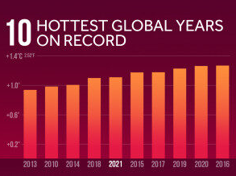
Summary of climate science
Emissions of greenhouse gases have risen since the industrial revolution
These emissions have enhanced the greenhouse effect leading to rising average global temperatures
As a result, the 10 hottest global years on record have all occurred within the last 13 years
For 2021, the average temperature across global surfaces was 1.51°F (0.84°C) above the 20th-century average.
Unconfirmed met office records show UK recorded its hottest year in 2022.
Notes:
Delivery: SE
Read the slide out.
The current and projected impacts of our rising global temperature will be explored in our next session.
Any questions?
TIMECHECK: 1HR 15MINS
Sources
Bbc web site for UK records
WMO https://public.wmo.int/en/media/press-release/2020-was-one-of-three-warmest-years-record
Diagram: https://medialibrary.climatecentral.org/resources/2020-in-review-global-temperature-rankings

Slide 25
5-minute break time!
Photo credit: Rumman Amin (Unsplash.com)
Notes:
TIMECHECK:

Slide 26
Climate change action and inaction
Notes:
Delivery: GS
Introduce inaction: we’ve known since the 1970s that climate change is a very real threat both to our natural environment and to human communities. Since then, we’ve seen some incredible actions taken by individuals and groups to raise awareness and provide solutions to climate change, but currently we are still dealing with the problem of mass inaction when it comes to tackling climate change. Remind people about the opening video.

Slide 27
What is behind inaction?
Political preference
It’s too complicated
It’s too late!
Fake news
Confusing science
Time constraints
‘They’ will fix it
Financial constraints
I'm not sure how to act
It doesn’t match my world view
It’s not my responsibility
I’m just one person
Notes:
Delivery: GS
Which do think is the most likely reason people don’t do any thing about carbon?
1.) ‘It’s someone else’s job to address climate change’
2.) ‘I’m just one person, I can’t make a difference’
3.) ‘I don’t have the time or money to address climate change’
4.) ‘Information about climate change is confusing’
5.) ‘It’s too late, so why try?’
ACTION: invite learners to briefly explain what their answer was

Slide 28
‘But I’m only one person, I can’t make a difference’
Notes:
Delivery: GS
Take a look at this image and think about what it is trying to say.
One of the biggest challenges we face around climate change is a feeling that many of us experience: the feeling of being too small to make a difference, and then turning away from the issue because we don’t feel any real sense of agency.
It’s important to remember that together we can have a huge impact… link to examples.
Possible examples to include:
High profile example of Greta Thunberg and other climate activists
Collective impact of eating a more plant-based diet - daily meat consumption has fallen 17% in the past ten years
Local examples e.g. KB example of student action at the University of Worcester to reduce water consumption
ACTION: ask learners to share examples of actions they are already taking. Here, illustrate the collective impact of actions just from actions taken by the people in this session.

Slide 29
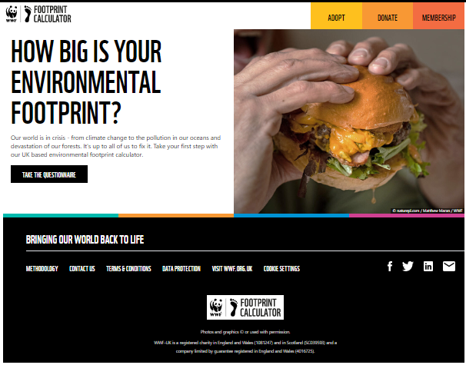
Your own carbon footprint
Please work through the WWF carbon footprint calculator and reflect on your results.
Note: when calculating your footprint, please do so for a typical year (not affected by COVID-19 restrictions) e.g. 2019 - 2020
Notes:
Delivery: GS
Link to tool: https://footprint.wwf.org.uk/
ACTION: post link to tool in the chat box
Introduce the carbon footprint calculator and explain how it works. Ask everyone to have a go at calculating their carbon footprint by working through the questions for a year that hasn’t been affected by Covid, so for example 2019 -2020.
We’ll give everyone around 10 minutes, but we can extend this if people need longer, and whilst you’re working through, we will be quiet so you can concentrate, so don’t worry if you don’t hear much out of us for the next few minutes.
ACTION: about 10 minutes in, ask learners to select the ‘view full results’ option when they reach the end of the calculator.

Slide 30
Group discussion of carbon footprint results
If you are happy to share your results, feel free to pop them in the chat box.
Was your footprint larger or smaller than you expected?
Was there any result that surprised you?
Has this prompted you to make any immediate changes?
Notes:
Delivery: GS
Once you’ve finished, if you feel comfortable, you can post your results in the chat box.
NOTE: mention that this is not about ‘carbon shaming’.
TIMECHECK: 1HR 50

Slide 31
Your accreditation form
To gain certification from the Carbon Literacy Project, you will need to complete the form.
You do not need to start the assessment form now - we recommend you don’t begin the assessment until you have completed the first two sessions of the training.
Notes:
Delivery: KB
Start wrapping up with some time to discuss the assessment form.
ACTION: post link to STO Carbon Literacy page in the chat box – this includes session one materials and a link to the assessment form. Link: Carbon Literacy Training – susthingsout
Share screen with the Assessment/Evidence Form and talk participants through the different questions.
We are giving participants the opportunity to look through the assessment now so they can bare it in mind as we move through the training, but we recommend participants don’t start the assessment until they have completed the first two sessions. We will have more of a discussion about the assessment and what is expected of everyone to pass at the end of the final session.

Slide 32
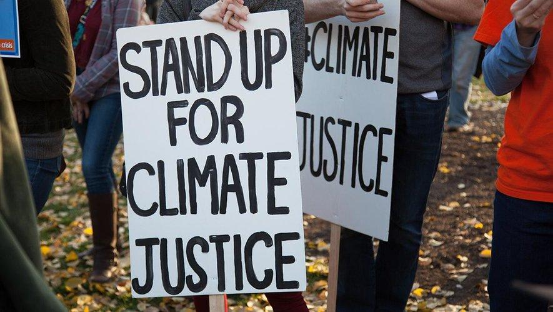
Next session we will:
Examine the impacts of climate change
Explore the distribution of impacts and reflect on climate justice
Consider possible future scenarios
If you have any questions about the course, you can contact Gill g.slater@worc.ac.uk
Notes:
Delivery: KB

Slide 33
Homework
Before the next session, watch this video: https://www.youtube.com/watch?app=desktop&v=EOctIuyVfnA
In the video, there is a discussion about communities that emit the least carbon emissions also being those that are most likely to suffer the most severe impacts of climate change.
Can you list two countries that you think will be most impacted by climate change?
Can you list two countries that you think will be least impacted by climate change?
What does this reveal to you?
Notes:
Delivery: KB
Before next session, please watch the video and have a think about the questions on the slide.
ACTION: remind learners they can access slides with links at STO and that they should do this to complete the homework

