Slide 1



Session 2: Climate Change Impacts, Climate Justice, and Future Scenarios
Adapted for the University of Worcester by Katy Boom, Sian Evans, Gill Slater,
Notes:
Delivery: KB
Before you begin have ready to go in the chat box
Have all video links open so these are ready
https://www.youtube.com/watch?v=E8Y6L5TI_94 (recap)
https://susthingsout.com/wp-content/uploads/2023/02/global-social-impacts-slide.pptx
https://www.bbc.co.uk/news/av/science-environment-58677993
https://www.carbonmap.org/#intro
https://susthingsout.com/carbon-literacy-training/
Have both futures slides ready
Welcome to session two of our Carbon Literacy training. Today we will be examining climate change impacts, thinking about climate justice and exploring different potential future scenarios.
ACTION: ask learners to pop in chat box anything that arose from the independent learning task/homework

Slide 2
Independent Learning
In the video, there is a discussion about communities that emit the least carbon emissions also being those that are most likely to suffer the most severe impacts of climate change.
Can you list two countries that you think will be most impacted by climate change?
Can you list two countries that you think will be least impacted by climate change?
What does this reveal to you?

Slide 3
Session 2: learning outcomes
Consolidate understanding of the learning outcomes from session one
Explore the consequences of not taking climate action
Learn about the countries that are the most vulnerable to climate change and the countries that are responsible for the most emissions, both currently and historically
Explore various carbon reduction actions that lead to a positive future
Notes:
Delivery: KB

Slide 4
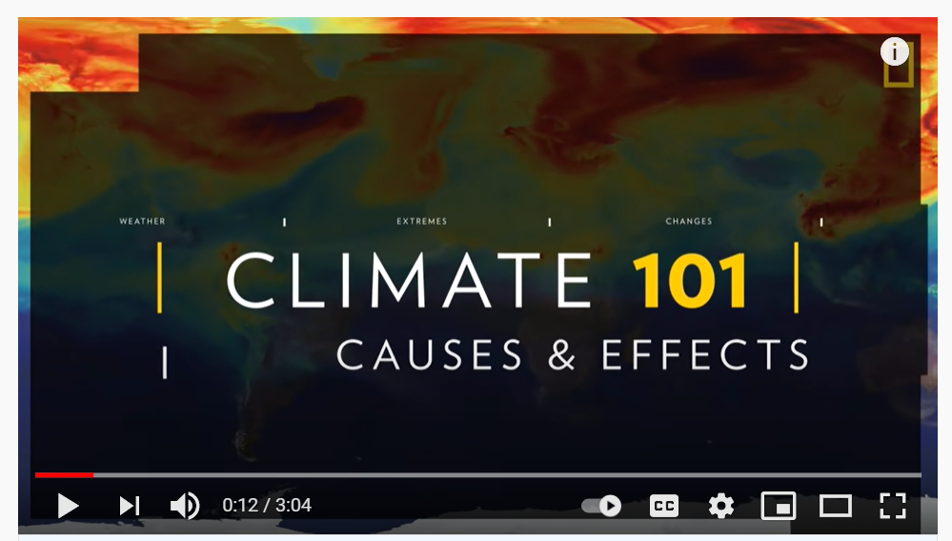
Consolidate learning from session one
Watch the video to recap learning from session one.
Any comments or questions before we get started with session two?
Notes:
Delivery: KB
Link to video: https://www.youtube.com/watch?v=G4H1N_yXBiA
Duration of video: 3:04
Last session we looked at the causes of climate change. To recap this, and begin introducing some content for today’s session, for example health affects, for today’s session, we’re going to watch this three minute video. National Geographic so it’s USA based.
ACTION: add video link to the chat – learners should watch the video themselves (do not screenshare).
Ask if anyone has any outstanding questions from the previous session.
TIMECHECK: 10 minutes (after the video and questions)

Slide 5
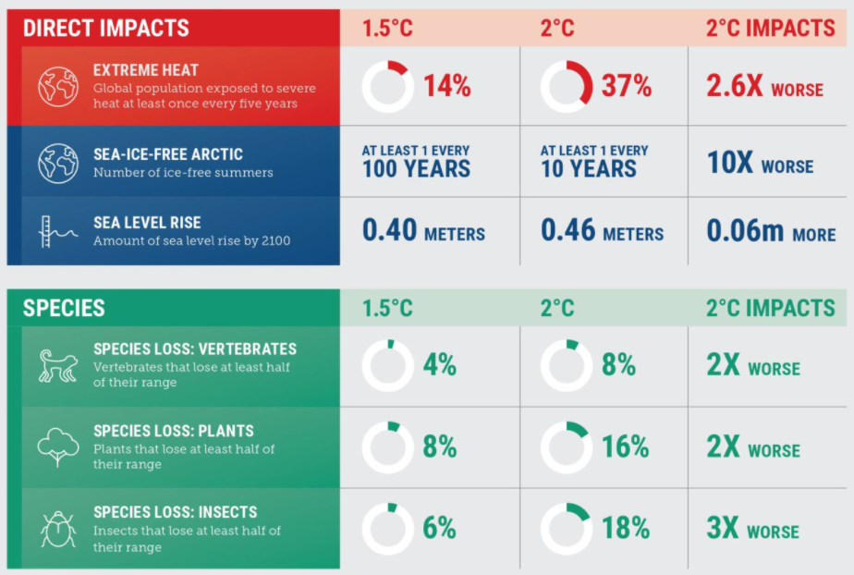
Global environmental impacts of climate change
Notes:
Delivery: SE
We are going to begin today's session by exploring some of the potential global environmental and social impacts of climate change in more depth.
We began to look at some of the impacts already happening in the introductory video last week, you may remember the phenomenon of increasing heat domes, which amplify hot weather? Other global impacts already attributed to climate change include rising sea levels, droughts and increasing extreme climate events such as hurricanes/cyclones etc.
Unless action is taken to reduce greenhouse gases these impacts will increase in both frequency and intensity, ultimately it depends what we do as a global population to tackle this issue.
The year 2020 was 1.2°C above pre-industrial era (1880) temperatures.
Scientists are demanding global action to tackle climate change and prevent temperatures from rising 1.5°C above pre-industrial levels.
This infographic highlights the importance of not moving beyond a 1.5°C rise in temperature. It shows the extent of impacts grows significantly if we move beyond this point to a 2°C increase.
ACTION: Request the group explore the infographic for a few moments looking at both the direct impacts and those on species, and invite them to add any comments or questions to the chat box.
Add comment to chat box to get people started. 'What stands out for me is the sea ice – the number of ice free summers in the Arctic would be 10x worse with a 2 degree warming scenario'.

Slide 6
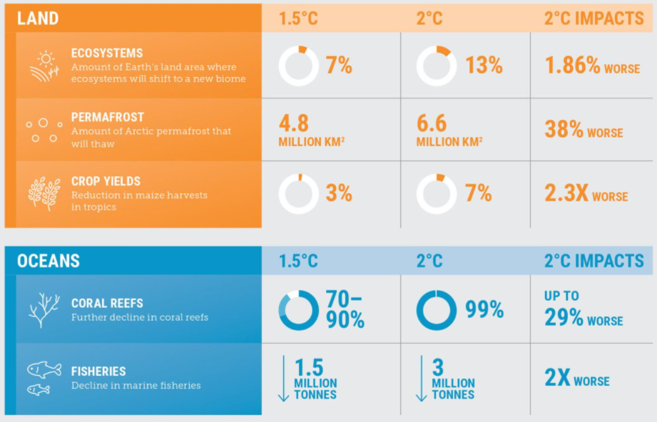
Global environmental impacts of climate change
Notes:
Delivery: SE
If we look at the impacts to land use and oceans there are some more shocking statistics.
Action: Again ask audience to add any comments or questions to the chat box.
Prompt the group to consider permafrost thawing and the release of methane this would involve (and consequent positive feedback).
Prompt them to also consider the bleaching of coral reefs, instigated by temperature rise and exacerbated by ocean acidification, a 2C temperature rise will wreak absolute devastation causing a 99% decline with significant consequences for the biodiversity they sustain. Remind them of the film at the beginning of session one regarding how extreme heat had affected US fisheries.

Slide 7
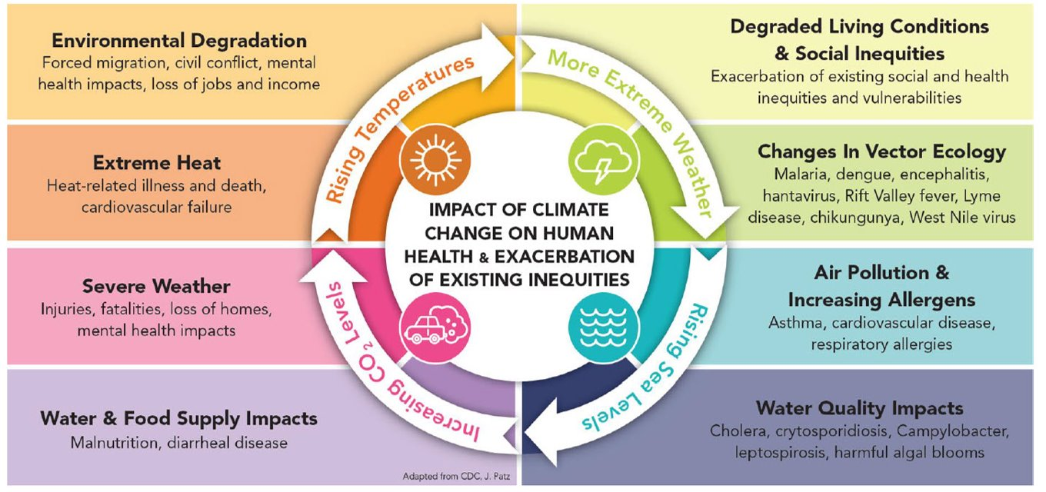
Global social impacts of climate change
Notes:
Delivery: SE
We’ve looked at some of the environmental impacts of climate change, but it’s important to put these in the context of the social impacts caused by changes to the environment from climate change. The very real and significant impacts that all this will have on both us and others throughout the world.
Which of these impacts have you come across before today?
Are any of the impacts new to you?
Does anything about this infographic surprise you?
https://susthingsout.com/wp-content/uploads/2023/02/global-social-impacts-slide.pptx
ACTION: This slide explores the impacts that climate change has on human health and how these exacerbate existing inequalities. Please think of the central circle as being in motion, all influencing a range of boxes. Move to next slide to explain activity.

Slide 8
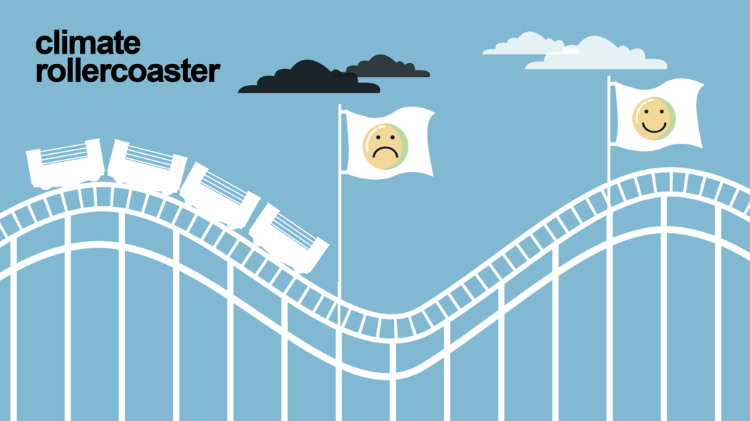
This is a hard-hitting film about climate vulnerability and inequality
Notes:
Delivery: GS

Slide 9
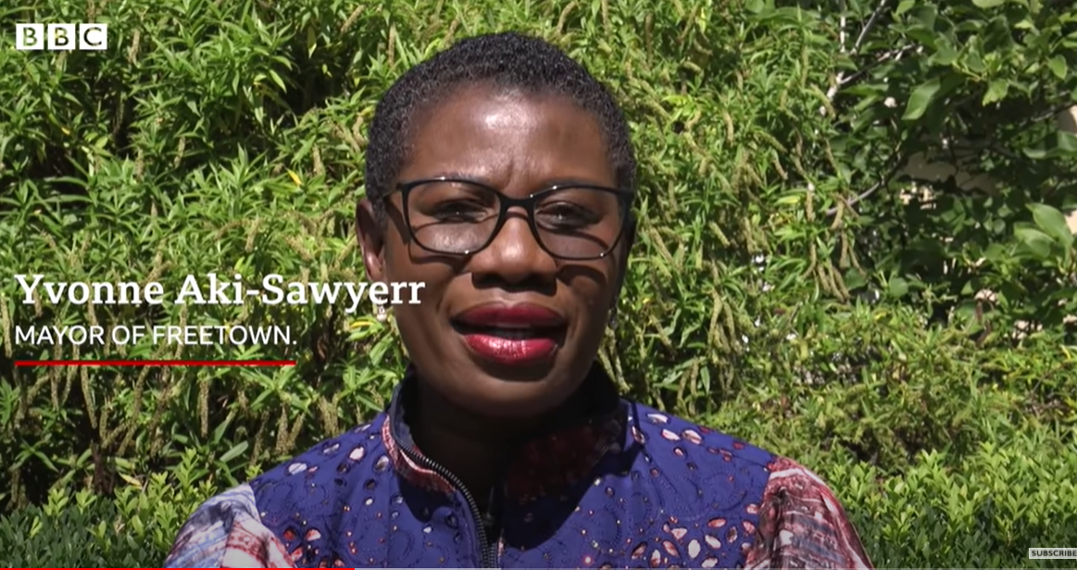
How climate change is making inequality worse, especially for children
Notes:
Delivery: GS
Link: https://www.bbc.co.uk/news/av/science-environment-58677993
Duration of video: 4:37
ACTION: add video link to the chat – learners should watch the video themselves (do not screenshare).
Climate change is unequal in its impacts both within and between countries. How people experience climate change is strongly linked to poverty, as we will see in this video.
We are going to watch a video about how climate change is exacerbating inequality, especially for children. Trigger warning – video is quite upsetting.

Slide 10
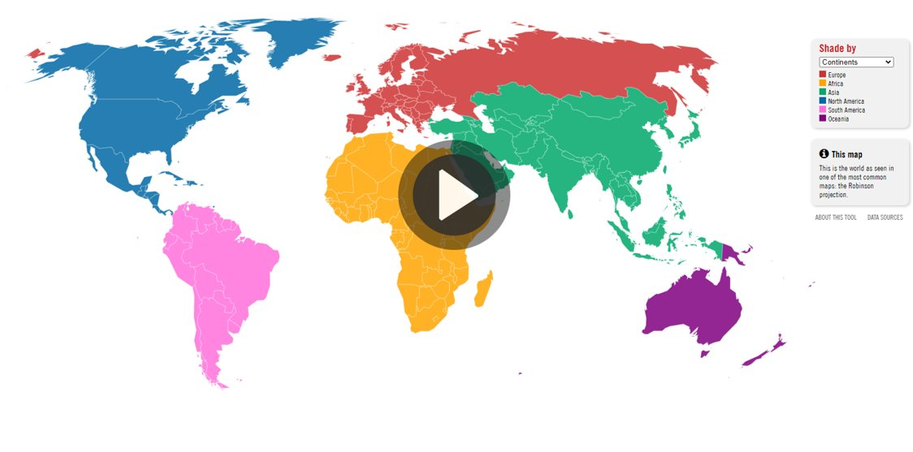
Carbon map
1.) Follow the link to the carbon map online tool
2.) Watch the introductory video explaining how the tool works
3.) Browse categories under the responsibility tab (avoid vulnerability for now) – what does this tell you about the global distribution of responsibility for climate change?
Notes:
Delivery: GS
https://www.carbonmap.org/#intro
ACTION: post link to the carbon map in the chat box.
Read slide and emphasise that at this point, we just want delegates to explore the responsibility tab. We will come back to vulnerability shortly.
Give delegates 6 minutes to play with the tool and ask them to pop any comments in the chat box.
Time check 30 minutes

Slide 11
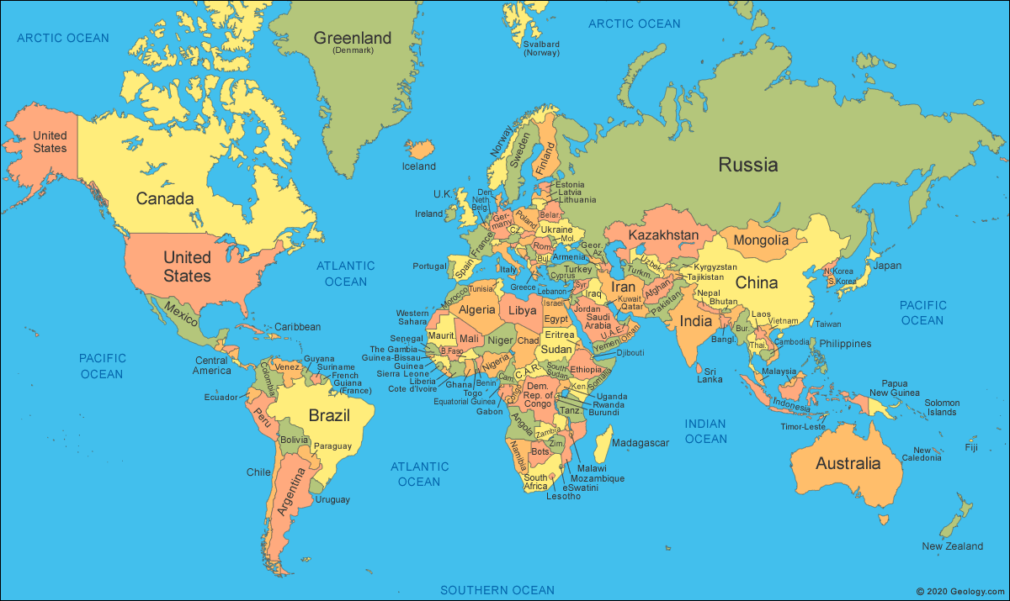

Exploring responsibility…
We have identified the causes and consequences of climate change. The next step is to understand how responsibility for climate change and climate impacts varies between nations based on both historical and current emissions.
Notes:
Delivery: GS
Now that we understand some of the impacts of climate change, we can begin to explore who is and who isn’t responsible for climate change.
To do this we are going to use an online tool.

Slide 12
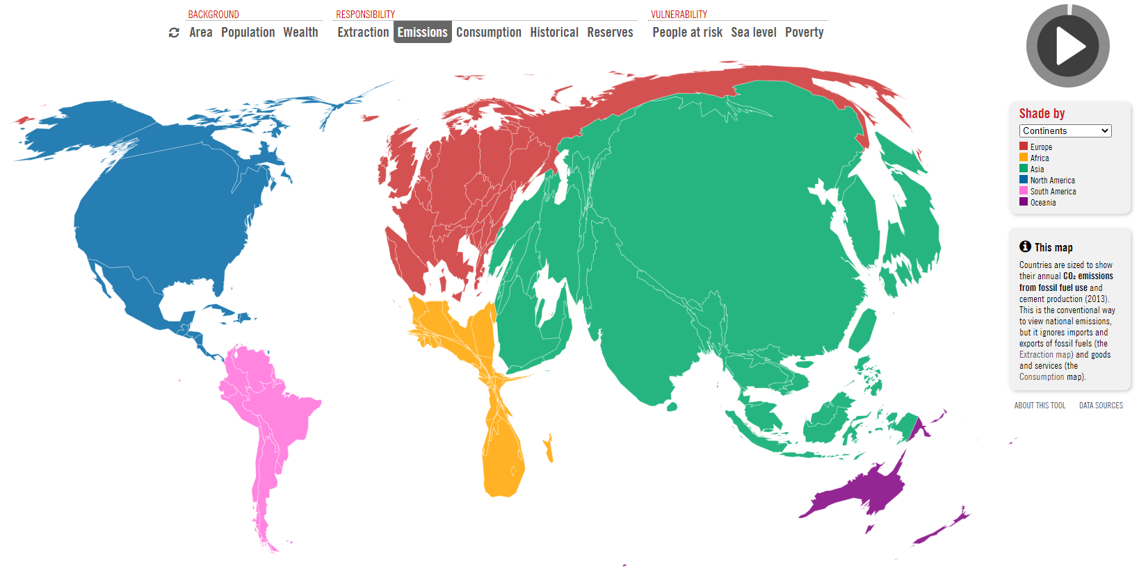
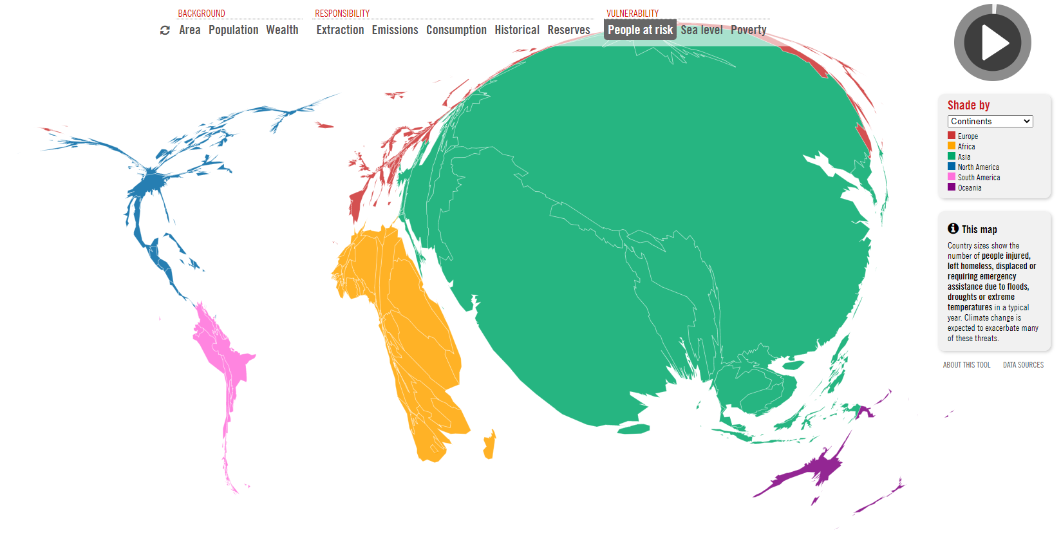
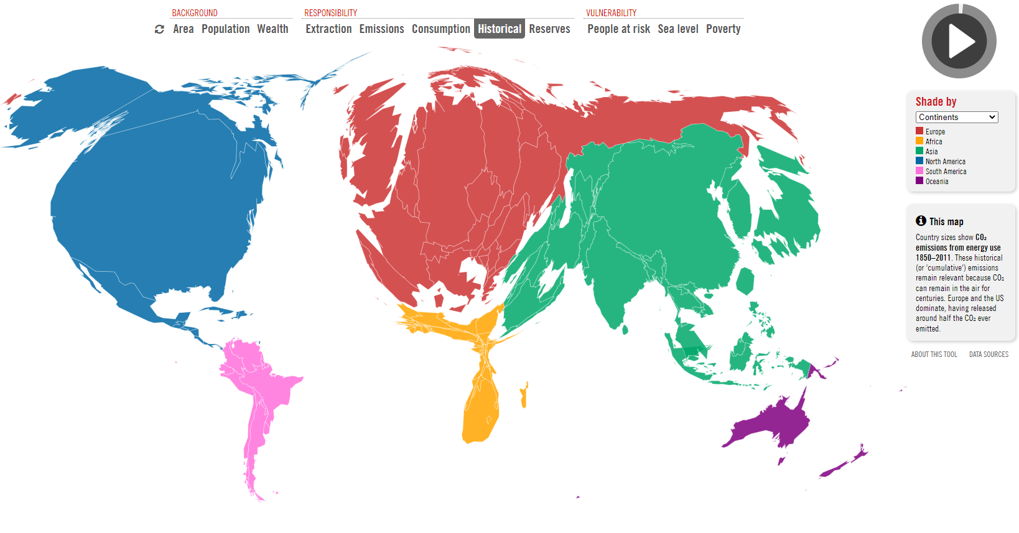
Emissions today
People at risk
Historical emissions
Notes:
Delivery: GS
The video we just watched clearly shows that climate vulnerability is much higher in some places, and for some groups of people. The maps above are stills taken from the carbon map which show how where emissions are and have been produced does not match up with where in the world people are most vulnerable to the effects of climate change.

Slide 13
Discussion
‘The world's wealthiest 1% produce double the combined carbon emissions of the poorest 50%.’ Yet people from developing countries are most at risk to the impacts of climate change.
Report from the Cambridge Sustainability Commission April 2021
Notes:
Delivery: GS
We realise that looking at responsibility is an emotive topic, so we want to give some time now to have a discussion about this.
ACTION: ask leaners to think about how this information applies more specifically to the UK context
TIME CHECK: 1hr (after discussion)

Slide 14
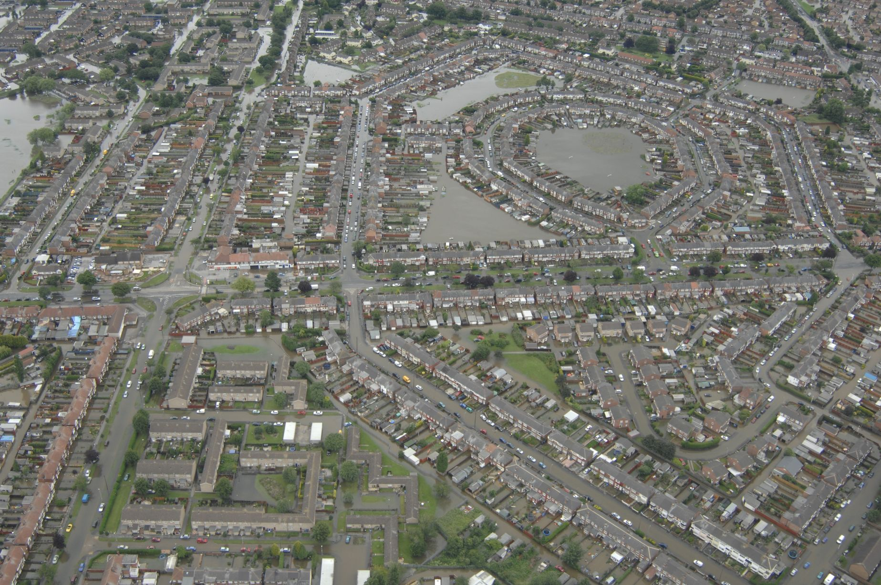
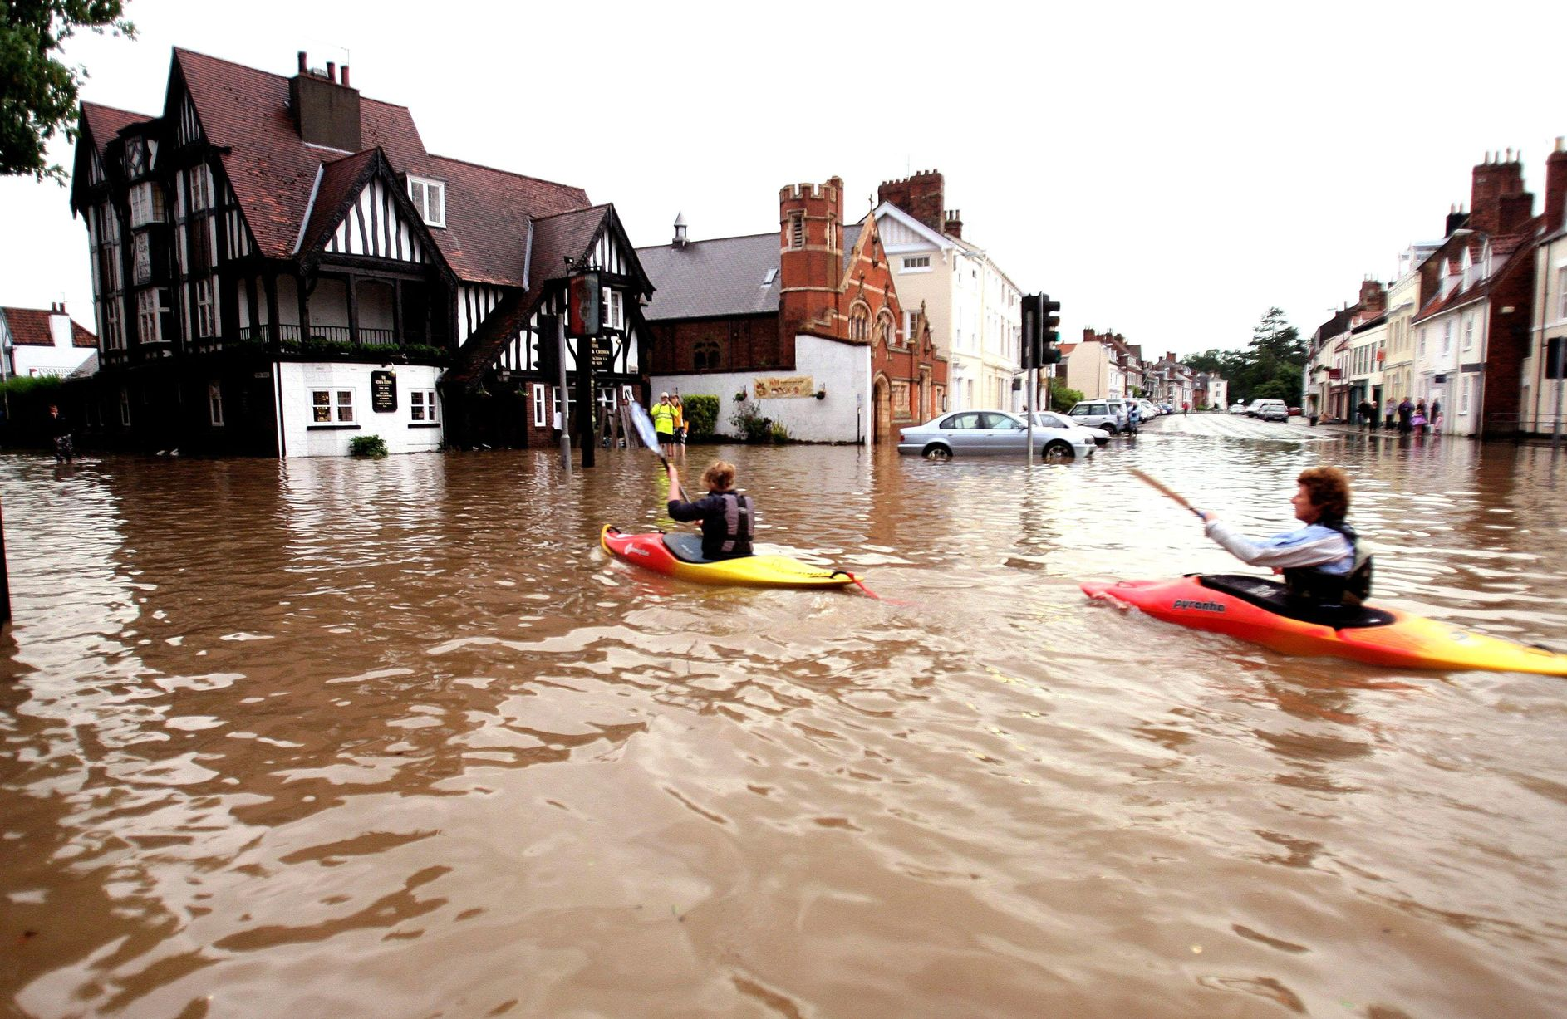
UK social impacts of climate change
Notes:
Delivery: GS
ACTION: ask leaners if they know where this photo was taken (answer is Hull)
There’s often more familiarity with the unequal distribution of impacts of climate change when we think about it in global terms (as we’ve just discussed), however the impacts of climate change are also unevenly felt in the UK, with less privileged communities often bearing the worst impacts.
Flooding:
Risk of flooding is projected to increase significantly across the UK
Poorer households can do less to protect their homes and are less able to pay high insurance premiums
House prices will decrease as flood risks increase
Less privileged communities may have less resources and support available to them to cope with flooding
Yorkshire and the Humber is one of the regions most affected due to a combination of high social vulnerability and high likelihoods of flooding
Why is this relevant to us?
The University of Worcester regularly floods
Many of Sanctuary’s homes are in Hull (the most flood-prone area of the UK) consider what this means for Sanctuary’s residents, and implications for Sanctuary as a social housing provider that owns homes in increasingly at risk areas of the UK
Platform owns homes in Upton upon Severn and other flood-prone towns in the Worcestershire area.
Overheating:
Risk of overheating is set to increase significantly across the UK
Heavily concreted areas will feel the effects of this – the cooling effects of green spaces are more common in wealthy districts of cities
People in less privileged areas may not be able to afford air conditioning units, and for some this mat be compounded by an inability to open windows e.g. on ground floor flats, or due to concern about crime
Why is this relevant to us?
Overheating poses health concerns, especially to young, elderly and vulnerable people
Sanctuary has homes in London (most at risk region of overheating), and both Sanctuary and Platform own high-rise accommodation
Sanctuary owns close to 100 care homes with elderly residents who are more at risk to overheating
Summarise: the injustice of climate change isn’t something we’re only experiencing at the international level, it’s also a national and regional issue.

Slide 15
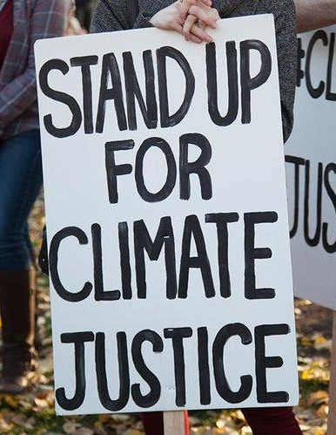
Understanding climate justice
Climate justice is a concept that recognises the ethical dimensions of climate change.
It recognises that those most affected by climate change have a disproportionately low responsibility for causing the emissions responsible for climate change.
By highlighting this, climate justice places responsibility on nations and/or groups that are historically responsible for climate change to significantly reduce their emissions and provide solutions to climate change that protect vulnerable nations and/or groups from its worst effects.
By participating in this training you are gaining the knowledge and skills to have a positive impact and be part of the solution.
Notes:
Delivery: GS
To wrap up what we’ve looked at, finish by defining climate justice.
ACTION: invite learners to read the slide themselves
Something that's very important about climate justice is that it provides an understanding of how we can allocate responsibility in order to understand who should be delivering climate solutions.
TIMECHECK: 1hr 5mins

Slide 16

5-minute break time!
Photo credit: Rumman Amin (Unsplash.com)
Notes:
TIMECHECK: we should be restarting at 1hr 10mins.
Set up break out into 2 teams
Prepare word doc

Slide 17
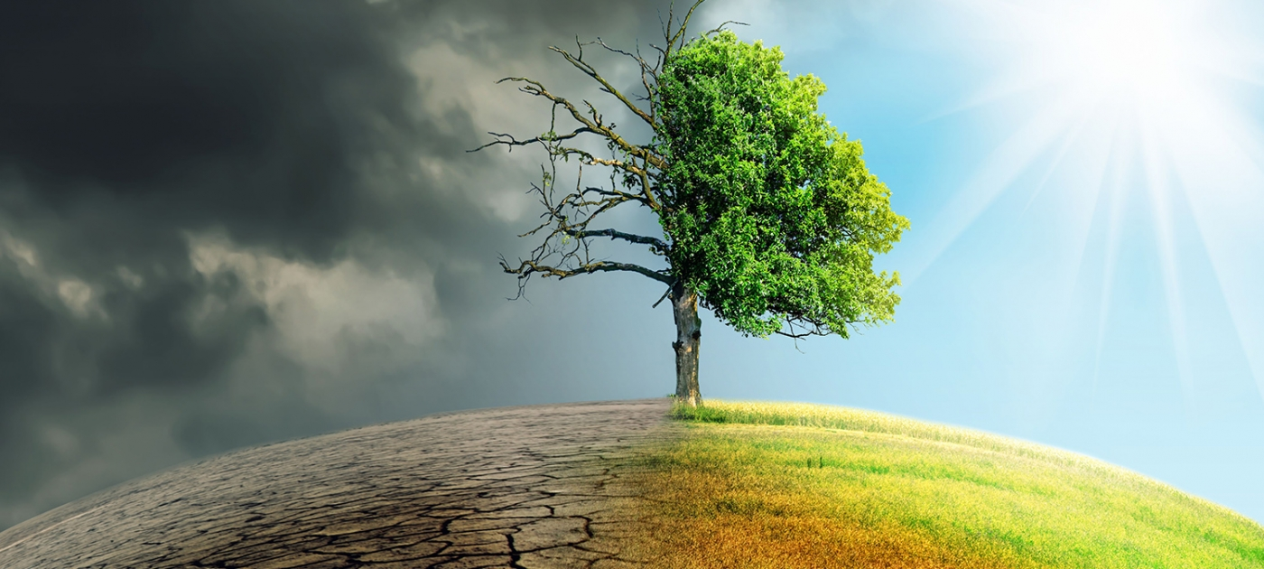
Climate change: future scenarios
Notes:
Delivery: KB
For the final section of this session, we’re going to spend some time looking at different future scenarios based on the actions we take for climate change across the 2020s. To do this we’ll be completing two activities together – in the first activity we’ll be exploring a troubled future scenario which we have arrived at due to inaction on climate change, and in the second activity we’ll finish on a more hopeful note, exploring what a sustainable future looks like and the steps we might take as a society to get there.

Slide 18

Activity one: troubled future
How did we get here? Consider what actions were (or were not) taken that led us to this troubled future.
In teams
decide which five of these (in) actions contributed the most to the troubled future scenario.
Take note of the five you decided on to feed back to main room.
There is no right or wrong answer.
Notes:
Delivery: KB
We’ve set up what our troubled future looks like. Now, we’re going to think about how we got there, how we got from here to there, and we’re going to do that together in breakout rooms as a team activity.

Slide 19
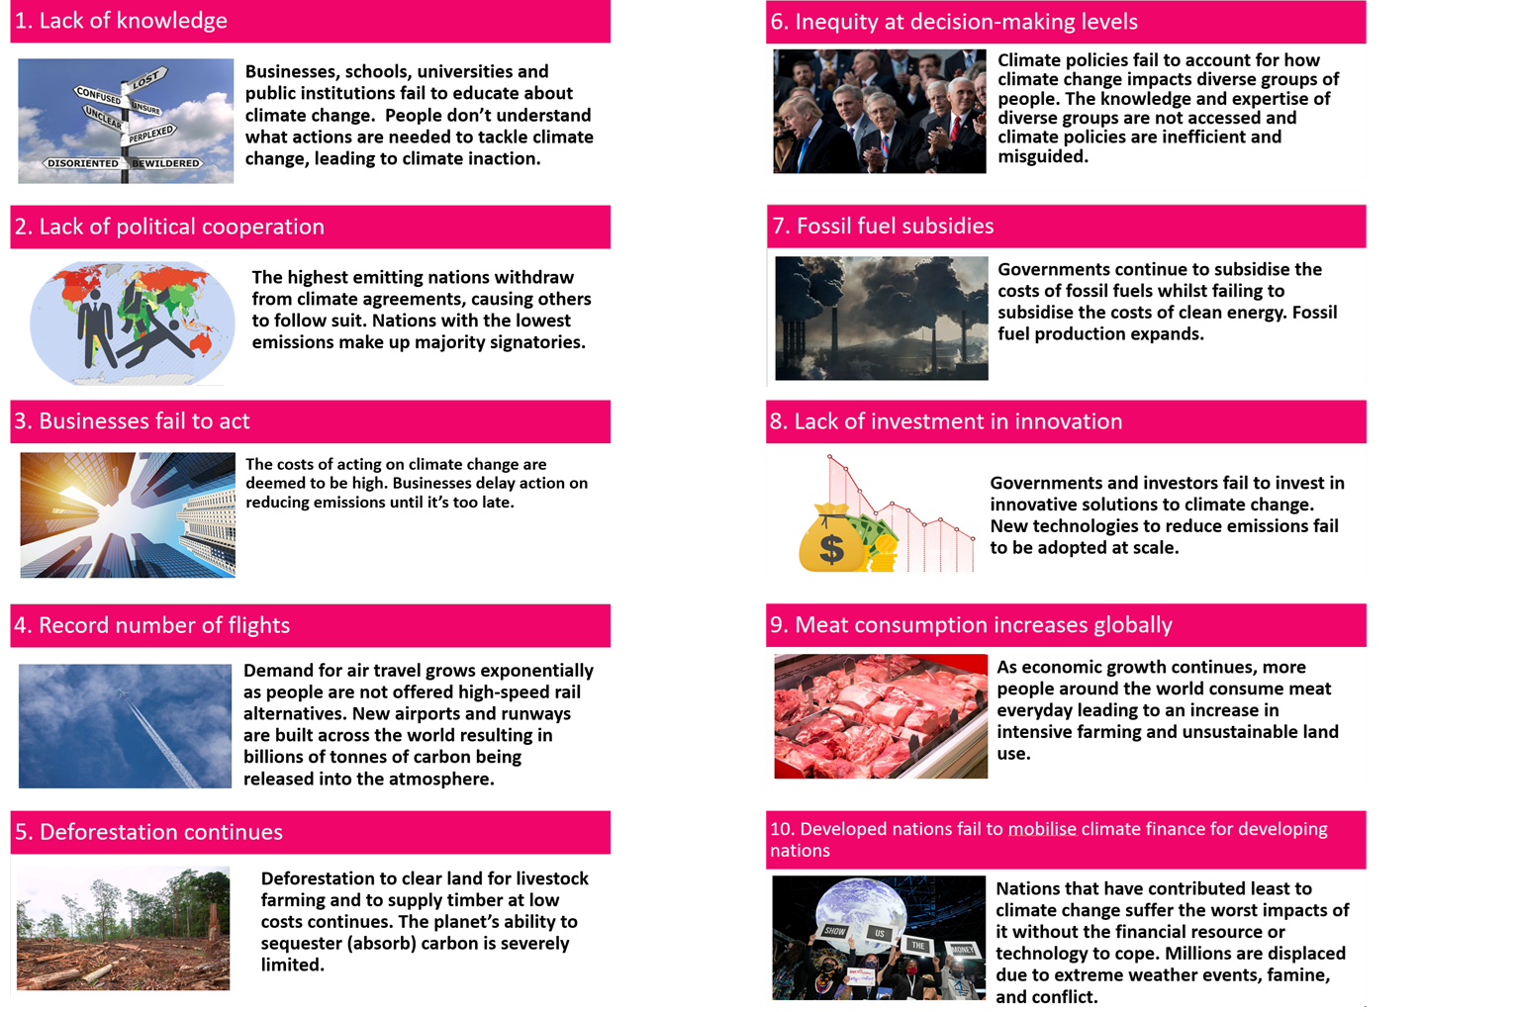

Slide 20
Activity two: positive future
How did we get here? Consider what actions were taken that led us to this positive future.
In teams:
Decide which five of these actions contributed the most to the positive future scenario.
Take note of the five you decided on as a group to feed back to main room
There is not a right or wrong answer.
Notes:
Delivery:
Repeat format of previous activity

Slide 22

Climate quiz
Notes:
Delivery: KB
Quiz questions
What is climate justice?
A concept that recognises the ethical dimensions of climate change.
A concept that suggests all countries will be affected in the same way by climate change
An annual United Nations climate summit
Historically, which countries have produced the most carbon emissions?
Developing countries
Developed countries
All countries have contributed equally
Which countries are most at risk of the impacts of climate change?
Developing countries
Developed countries
All countries are at equal risk
Which of these actions has a negative impact on the climate?
An increase in tree planting initiatives
A reduction in meat consumption
An increase in the number of domestic flights taken
Which of these actions has a positive impact on the climate?
Deforestation
Transitioning to renewable energy sources
Increasing fossil fuel use

Slide 23

What is climate justice?
A concept that recognises the ethical dimensions of climate change.
A concept that suggests all countries will be affected in the same way by climate change
An annual United Nations climate summit
Add your answer into the chat box
Notes:
Answer question by typing in the chat
Answer is answer 1

Slide 24
Historically, which countries have produced the most carbon emissions?
Developing countries
Developed countries
All countries have contributed equally
Add your answer into the chat box
Notes:
Correct answer 2

Slide 25
Which countries are most at risk of the impacts of climate change?
Developing countries
Developed countries
All countries are at equal risk
Add your answer into the chat box
Notes:
Correct answer 1

Slide 26
Which of these actions has a negative impact on the climate?
An increase in tree planting initiatives
A reduction in meat consumption
An increase in the number of domestic flights taken
Add your answer into the chat box
Notes:
Correct answer 3

Slide 27
Which of these actions has a positive impact on the climate?
  Deforestation
  Transitioning to renewable energy sources
  Increasing fossil fuel use
Add your answer into the chat box
Notes:
Correct Answer 2

Slide 28
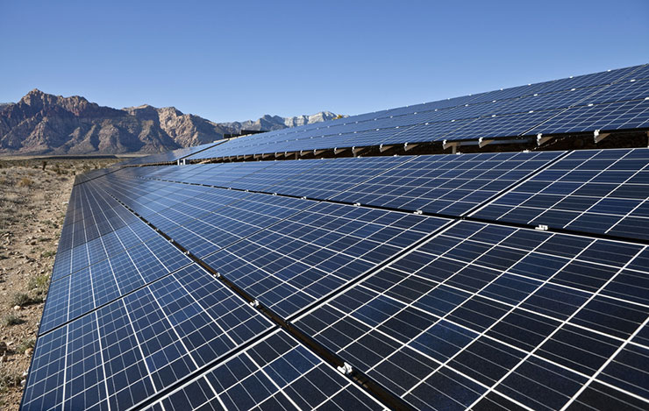
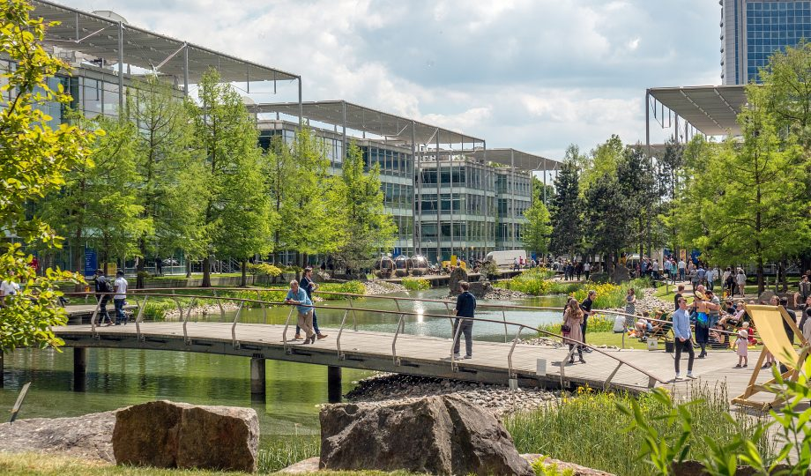
Next session we will:
Learn about action on climate change (including mitigation and adaptation) at various scales
Compare high and low carbon footprint actions
Devise high impact individual strategies
Consider ‘multisolving’ climate solutions
Devise high impact group strategies
If you have any questions about the course, you can contact Gill g.slater@worc.ac.uk
Notes:
Delivery: KB
ACTION: before closing session, reiterate that learners are already having a positive impact and taking steps towards a positive future by being here and engaging with the issue.

Slide 29
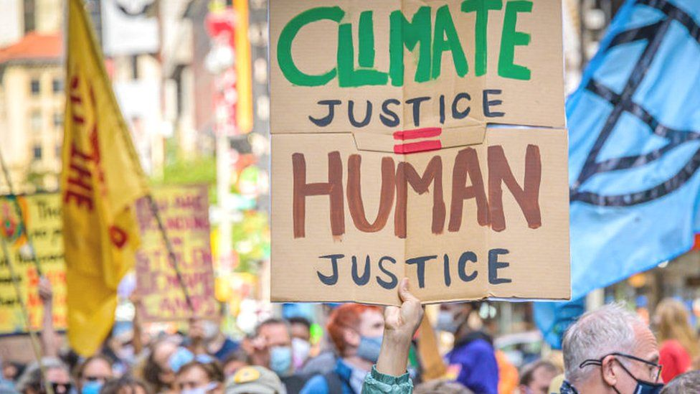
Recommended reading
Our World in Data: CO2 emissions (Our World in Data)
How calls for climate justice are shaking the world (BBC)
https://vimeo.com/790965733 Al Gore at the recent
Economic Forum Analogy of treating the atmosphere
as an open sewer!
Notes:
Delivery: KB
Reiterate to learners at close that we have worked with some uncomfortable messages as part of today's session and that by engaging with these and the training more generally, they are taking a big steps towards making a positive difference and being part of the solution to climate change and its impacts.

