Slide 1
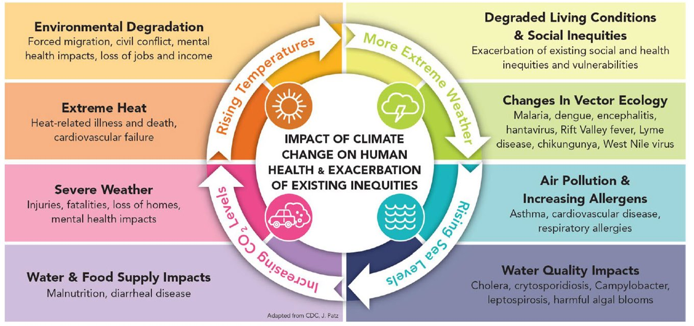
Global social impacts of climate change
Notes:
Delivery: SE
We’ve looked at some of the environmental impacts of climate change, but it’s important to put these in the context of the social impacts caused by changes to the environment from climate change. The very real and significant impacts that all this will have on both us and others throughout the world.
ACTION: This slide explores the impacts that climate change has on human health and how these exacerbate existing inequalities. Please think of the central circle as being in motion, all influencing a range of boxes. Move to next slide to explain activity.

