Slide 1
Session 3: Climate Solutions
Adapted for the University of Worcester by Katy Boom, Sian Evans, Gill Slater,
Notes:
Delivery: KB
Welcome to session 3 of our carbon literacy training. Today we will be our solution session examining climate change mitigation and adaptation and thinking about the individual actions that we can take to reduce our own carbon footprint and activities to prepare your solutions. Open all these tabs…
Tabs to be put into chat for session 3 (6 hour) online version
Slide 3 https://www.youtube.com/watch?v=EOW4fG-qlWU
Don’t put in chat KB to screen share
Slide 12 https://edition.cnn.com/interactive/2019/04/specials/climate-change-solutions-quiz/index.html
slide 14 https://www.bbc.co.uk/news/science-environment-46459714
Slide 16
https://www.imperial.ac.uk/stories/climate-action/ web site pdf https://www.imperial.ac.uk/media/imperial-college/grantham-institute/public/publications/Nine-things-you-can-do-about-climate-change.pdf
NOT IN CHAT KB TO PLAY slide 21
https://www.youtube.com/watch?v=SDRxfuEvqGg start at 5.55 end at 11.10 adaptation video
slide 28 https://www.youtube.com/watch?v=RkklaXhbTuA –
Slide 29 https://my2050.beis.gov.uk/?levers=111111111111111

Slide 2
During the training you will:
 | Session 1 - Science | Session 2 - Impacts
The Problem | Learn about the science of climate change Your individual carbon footprint | Examine the impacts of climate change Explore the distribution of impacts and reflect on climate justice Consider possible future scenarios
 | Session 3 – Actions
The Solutions | Learn about action on climate change (including mitigation and adaptation) at various scales Compare high and low carbon footprint actions Devise high impact individual strategies Consider ‘multisolving’ climate solutions Devise high impact group strategies
“Providing you with the tools to make a difference….”
Notes:
Delivery: KB
Read solutions

Slide 3
Summary film: from problems to solutions
Climate Change Committee (CCC): UK Climate Change
Notes:
Delivery: KB
The UK Adaptation Climate Change committee sets out the risks and opportunities for the UK in June 2021. This is again a summary of the first 2 sessions, in a UK context, before we move onto the solutions.
Link: https://www.youtube.com/watch?v=EOW4fG-qlWU
Duration: 3:17
ACTION: post link to video into the chat box for learners to view on their own screens (do not screenshare)
After watching the video, ask learners if there are any questions or comments before we get started with the session.

Slide 4
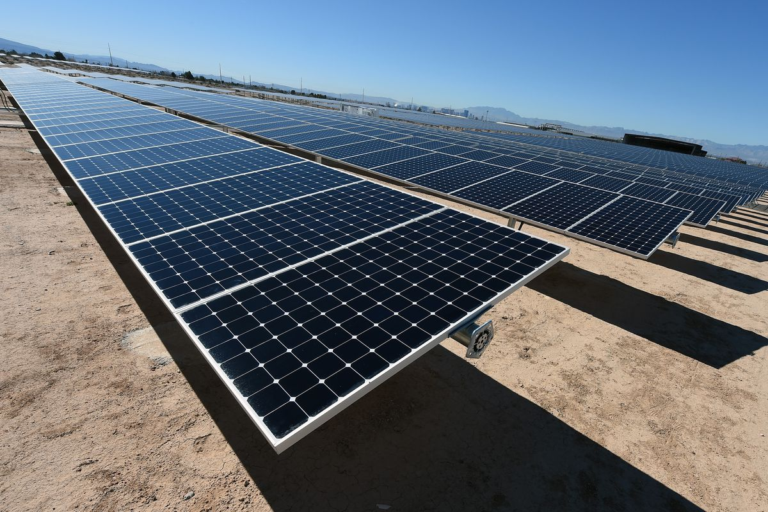
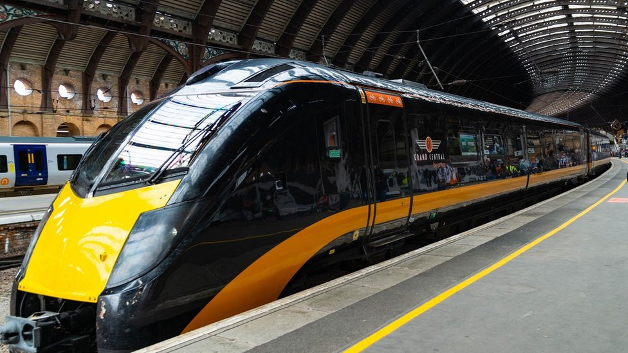
What is climate change mitigation?
Mitigation refers to activities which reduce the rate of climate change. The focus is on:
reducing Green House Gas (GHG) emissions
preventing new GHG emissions being released
preserving and enhancing sinks and reservoirs of GHGs
Thereby preventing / reducing climate change and avoiding its impacts.
Notes:
Delivery: KB
Read slide and refer to images as examples of mitigation such as shared transport rather than single occupancy cars, or PV using the sun to generate electricity rather than coal or gas powered power stations.
ACTION: invite learners to consider any other examples of climate mitigation they have come across and add these to the chat box.
Image: https://www.vox.com/energy-and-environment/2018/11/20/18104206/solar-panels-cost-cheap-mit-clean-energy-policy&sclient=img&ei=QkbpYY7YK8ekaMv5rqgH&bih=577&biw=1280&rlz=1C1GCEB_enGB939GB940#imgrc=NivV3HlsCe6SdM
Image: https://www.bbc.co.uk/news/uk-england-54810200

Slide 5
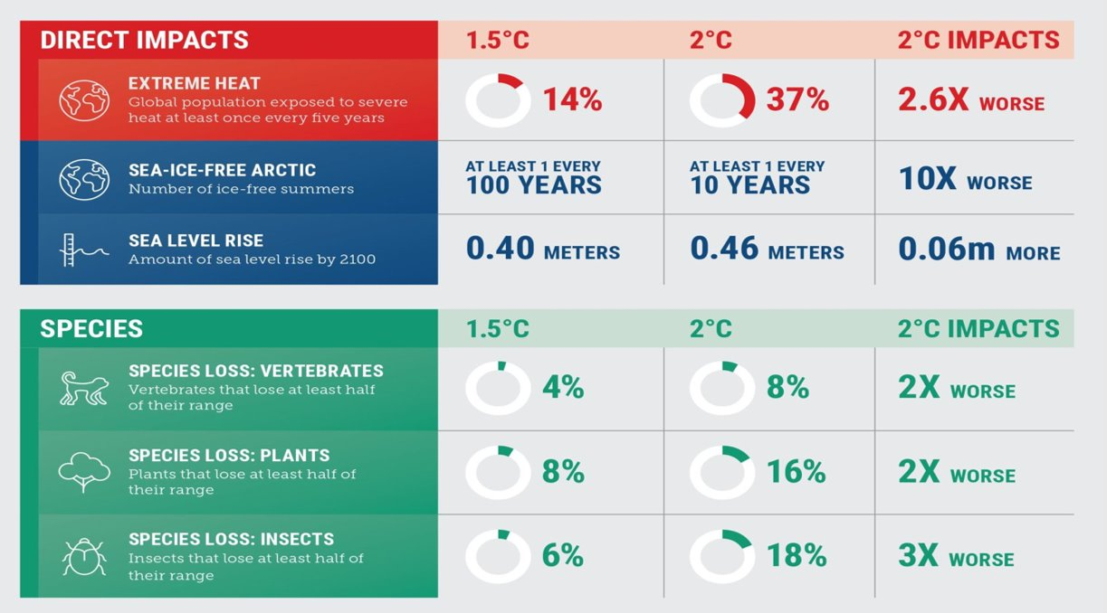
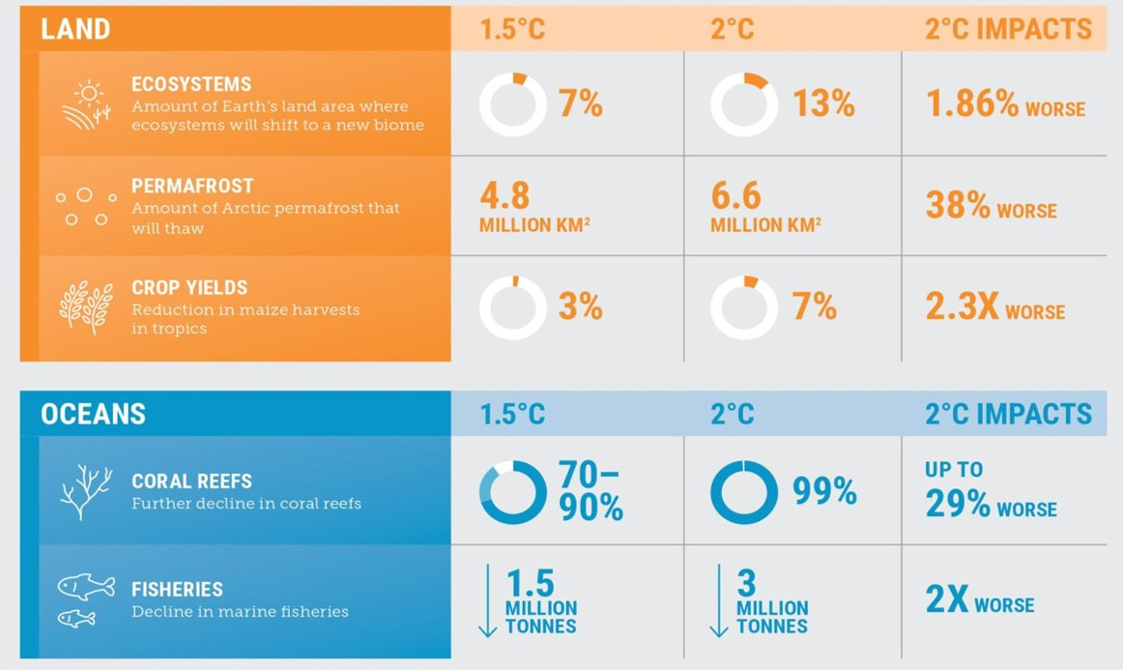
Why is mitigation important?
Reducing greenhouse gases is essential to prevent global temperatures exceeding 1.5ºC (and the catastrophic impacts that this would cause)
Notes:
Delivery: KB
We know from the work in previous weeks that reducing our emissions is essential to prevent global temperatures exceeding 1.5 degrees, we are at global average of over 1.1 degrees, and the IPCC have said that the current Paris Agreement emissions put us on a trajectory of 2.4 degrees warming. However, we are currently seeing much higher localised warming in some areas such as the Artic which is experiencing temperatures 4C above the 1990 baseline. The difference in the magnitude of damage between 1.5 and 2 reinforces the need for us to mitigate now.

Slide 6
Solutions - mitigating climate change
There are many high and low-tech solutions for mitigating climate change already in action, in progress or in R&D phase. Examples include:
Renewable energies and Heat Networks
Electric heat pumps (ground, air, water)
Electric vehicles
Hydrogen for HGVs
Afforestation/reforestation and peat restoration & rewilding
Improved public transport hubs and cycle networks
Carbon capture and storage
Notes:
Delivery: KB
Trainer to read through and briefly explain mitigating actions on the slide.

Slide 7
Responsibility for mitigating climate change
Responsibility for mitigating climate change is linked to multiple stakeholders:
Global institutions
Governments national and local - e.g. public services
Businesses (of all sizes in all sectors)
Non-Government Organisations (of all sizes in all sectors)
Individuals
“Our choices matter both at home and at work ”
Notes:
Delivery: KB
United Nations, IPCC The Intergovernmental Panel on Climate Change (IPPC), created by the World Meteorological Organization in partnership with the United Nations Environmental Program, is the leading international scientific body related to climate change research. The IPCC whose job it is to synthesise the outcomes of all the research being done on the causes, impacts and actions to tackle climate change. Their findings are published as reports on a regular basis.
UK Climate Change Act 2008 - An Act to set a target for the year 2050 for the reduction of greenhouse gas emissions; to provide for a system of carbon budgeting. The Climate Change Act 2008 makes it the duty of the Secretary of State to ensure that the net UK carbon account for greenhouse gases for the year 2050 is at least 100% lower than the 1990 baseline. It excluded aviation. When first published it was 60% cut by 2035. New target to slash emissions by 78% by 2035. The UK’s sixth Carbon Budget includes international aviation and shipping emissions for the first time, to bring the UK more than three-quarters of the way to net zero by 2050.
Unilever, Interface

Slide 8
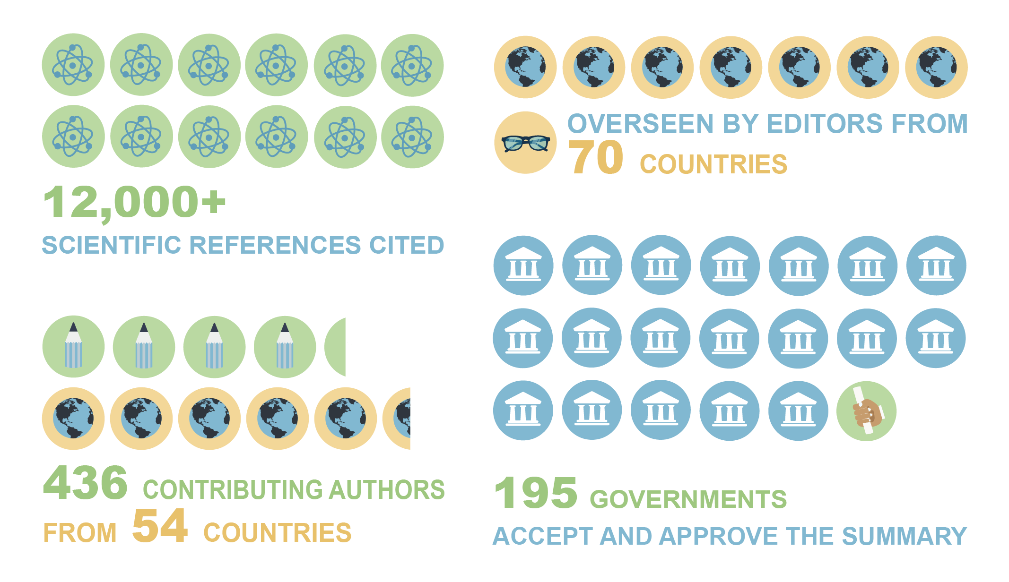
What is being done at a global level to mitigate climate change?
IPCC Reports on Climate Change
Global governance to mitigate climate change via the UN.
Key events and actions include:
Launch of Intergovernmental Panel on Climate Change (IPCC) (1988)
Kyoto Protocol (1997)
Paris Agreement (2015)
Annual COPs attended by nearly all countries – most recent COP 27 Egypt
COP28 United Arab Emirates
…… and 193 countries have signed up to the UN’s Sustainable Development Goals framework
Notes:
Delivery: GS
A global approach to mitigate climate change has been instigated via the United Nations. Their work includes key events and actions including:
The launch of the Intergovernmental Panel on Climate Change or IPCC whose job it is to synthesise the outcomes of all the research being done on the causes, impacts and actions to tackle climate change. Their findings are published as reports on a regular basis. The sixth assessment of the physical science of climate change was published in August 2021. The Impacts, adaptation and vulnerability published Feb 2022. April 2022 Mitigation of Climate Change.
The UN have also overseen the two major agreements setting targets for climate mitigation with the Kyoto Protocol in 1997 and the Paris Agreement in 2015.
The UN is also responsible for the annual Conference of the Parties or COPs which are a forum for making agreements on tackling this issue. As we saw in Glasgow last year, this process is exceedingly difficult. COP27 Egypt Nov 2022. The 28th session of the Conference of the Parties (COP 28) to the UNFCCC will convene from 30 November to 12 December 2023. It will take place in the United Arab Emirates.
Finally, a separate but equally important set of goals exist as part of the UNs framework of Sustainable Development Goals (SDGs).
Can add suggested reading follow up: Climate Change 2022: Mitigation of Climate Change
https://www.ipcc.ch/report/ar6/wg3/

Slide 9
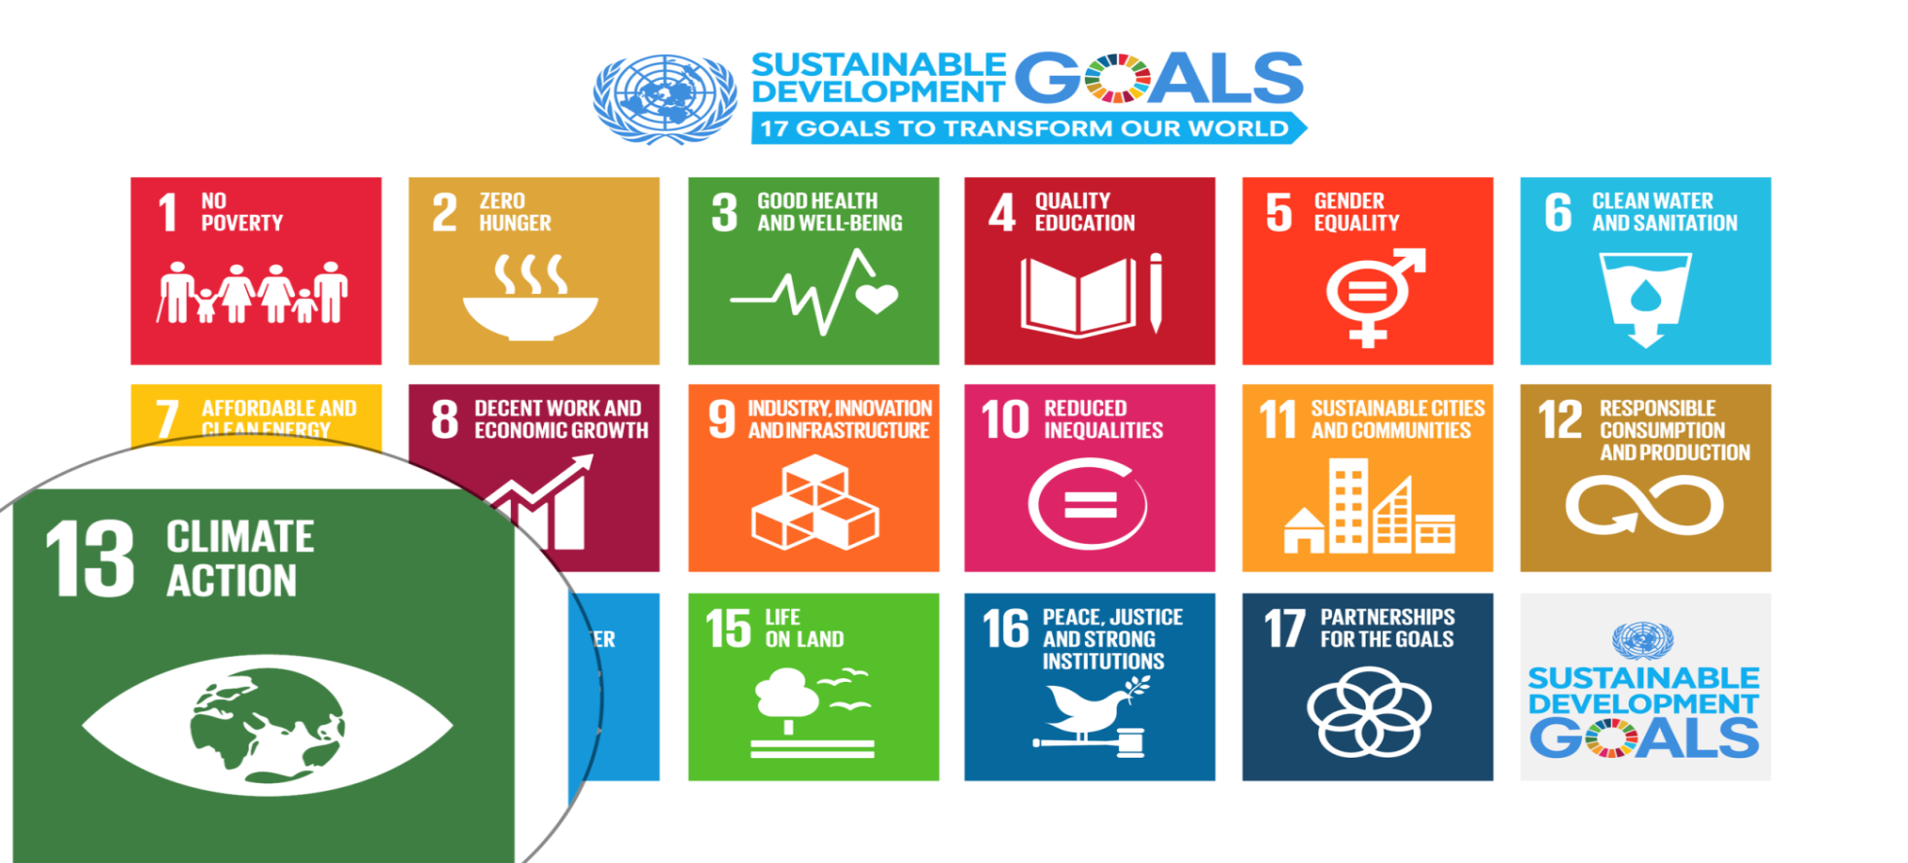
UN Sustainable Development Goals
Notes:
Delivery: GS
Climate Action is the thirteenth of the seventeen sustainable development goals established to tackle key global problems and offer a blueprint to a better future. These important goals were agreed in December 2015 by 193 countries with a completion date set for 2030.
If you would like to find out more about the SDGs then you can look at the following website after the session.
ACTION: add link to the chat box: https://sdgs.un.org/goals
Time check 20 mins Hand over to Gill

Slide 10
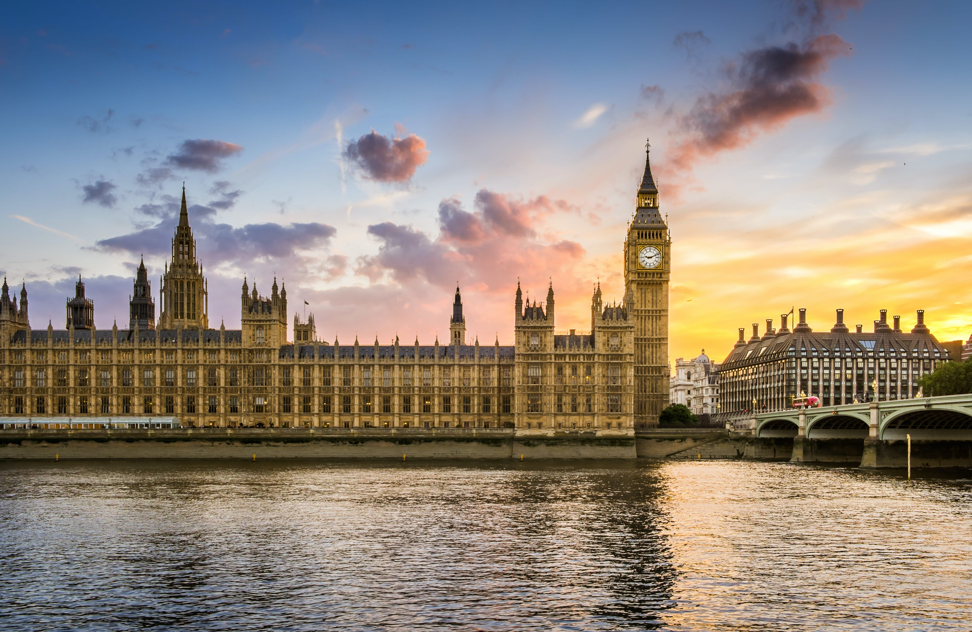
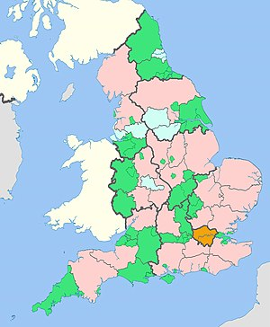
What is being done at the national level to mitigate climate change?
Notes:
Delivery: GS
ACTION: invite learners to consider what national and local government actions to mitigate climate change they’ve observed in recent years. Trainer can open this question out to the floor and once key national policies have been covered, invite learners to share examples of climate action in their local area (prompts below if needed)
National:
Net zero by 2050 (2045 in Scotland)
Biodiversity net gain 2023 etc.

Slide 11
What is being done at the local level to mitigate climate change?
https://www.worcester.gov.uk/climate-emergency/reducing-carbon-emissions
Notes:
Local – examples may include:
Development of cycling infrastructure
Waste collections e.g. adding food waste collection
Education initiatives etc.
Bring examples back to Worcester and make reference to Worcester City Council’s Environmental Sustainability Strategy – link: https://www.worcester.gov.uk/climate-emergency/reducing-carbon-emissions
NOTE: don’t spend time going through the commitments included in the snapshots of the strategy, just use this to signpost learners towards where they can find more information about what is happening in their local context.
Time check 25 mins

Slide 12
Understanding the impact of solutions
Solutions to mitigate climate change are found at multiple levels, including:
1. Our food
2. How we move people and goods
3. Our homes and cities
4. How we use our land
5. Electricity use
6. Materials and waste management
7. Empowering women
We can use the Project Drawdown/ CNN quiz to explore different solutions at these levels and compare their impacts.
Notes:
Delivery: GS/KB
Link to quiz: https://edition.cnn.com/interactive/2019/04/specials/climate-change-solutions-quiz/index.html
We are now going to use a tool that will allow us to look at the relative impact of taking different mitigation actions in each of the areas included on the slide. We'll have time to look at two or three, of the areas now and we encourage you to have a play with this quiz after today's session.
ACTION: Facilitator to screenshare the quiz and invite learners to rank the actions in order of impact. Demonstrate Qs 2,3,

Slide 13
Individual action on climate change
Notes:
GS
We've looked at some examples of solutions at various levels, but now we're going to focus in on the power of the individual and look at individual climate solutions that you can adopt in your daily life.
We saw in session one that a lot of us feel that we're too small to make a difference to climate change, but in this training we want to flip this feeling on its head and empower you to know that your actions do make a difference. To understand more about the power of individual action, the charity Jump - together with Arup - released a report earlier this year looking at the relative roles of individuals and governments and industry in reducing emissions. The research shows that citizens and communities are not powerless in protecting the planet, and that citizens actually have primary influence over 25-27% of the emissions savings needed by 2030, by making key lifestyle changes.
This 25-27% is actually a minimum figure for the impact of citizens because citizens can also have indirect influence on governments and industry, which are largely responsible for the remaining 73%. The report shows that government and industry have the most responsibility for reducing emissions, but it also highlights that systemic change and citizen action are two sides of the same coin.
For the rest of this session we're going to look at some examples of things you can do as an individual to reduce emissions, and if you'd like to take a look at the report we've included it in the additional reading slide at the end of the session.
Link to report: https://static1.squarespace.com/static/5f462d8d0b04df7da032a9bd/t/62252df0cc7bb27d653085a4/1646603770769/The+Power+of+People+-+The+JUMP.pdf
Hand over to Sian who will now take you through some case studies

Slide 14
Case study one: carbon cost of drink choices
Open up the BBC Food Carbon Footprint Calculator
In the box marked which food would you like? Enter your favourite drink and in the box marked how often do you have it? Select the option suitable for you
Scroll down and see how this compares to the footprint of other drinks
After you’ve done this, explore how your daily milk consumption compares to other milk types
Have any of the results surprised you? Please share any comments in the chat box
Notes:
Delivery: SE
Link: https://www.bbc.co.uk/news/science-environment-46459714
We are now going to do an activity to explore the carbon cost of different drink choices. We have another exercise up next which will look more closely at food.
Please note that this site provides a measure using carbon equivalents (I.e., all GHGs).
ACTION: do it shared not individually
If learners are interested in how these scores were calculated, signpost them to the very end of the web page where you will find the origin of the figures.
TIMECHECK: 48 minutes

Slide 15
Email and text uses less carbon than letters. Take care with email signatures especially images or icons
Notes:
SE replace buckets

Slide 16
More actions you can take
Make your voice heard by those with influence
Adopt energy saving behaviours to reduce your energy use (and bills)
Invest your money wisely
Cut consumption and waste
Respect and protect green spaces
Notes:
Delivery: SE
We’ve looked at communications, transport and food here are further actions you can take which we build on in our next activity.

Slide 17
Activity: individual actions
Read through the actions you can take for climate change. Remember the food, communication and transport case studies.
As you're reading through the actions, consider which of these you could adopt both at home AND in the workplace.
In breakout rooms, discuss the actions you could take as an individual both at home and in the workplace. Be sure to note down at least one action you could take at home and one you could take at work.
Notes:
Delivery: SE
Explain to learners that we will provide the link to a document called ‘nine things you can do about climate change’ and ask learners to read through this document. Once learners have read through the document, we will put them into breakout rooms to have a group discussion about individual actions they can adopt at home AND at work (emphasise that learners should be considering the workplace and that actions should be proportionate to their role). For example:
Make your voice heard by those who have influence – in your personal life, this might be writing to a local MP or councillor, but at work it might be getting in touch with your Line Manager or the organisation’s Sustainability team.
Invest your money wisely – in your personal life, this might be buying Fairtrade products, but at work it might be about speaking to HR about your pension provider and ensuring that your pension is supporting green investments.
ACTION: post link to nine things you can do about climate change doc in the chat box
https://susthingsout.com/wp-content/uploads/2022/06/Nine-things-you-can-do-about-climate-change.pdf
ACTION: after learners have had some time to read the actions, put them into breakout rooms to discuss (only about 5 minutes) - THIS CAN BE LOST IF WE DON'T HAVE TIME

Slide 18
5-minute break time!
Photo credit: Rumman Amin (Unsplash.com)
Notes:
Restarting at 55 mins – kept exactly to time

Slide 19
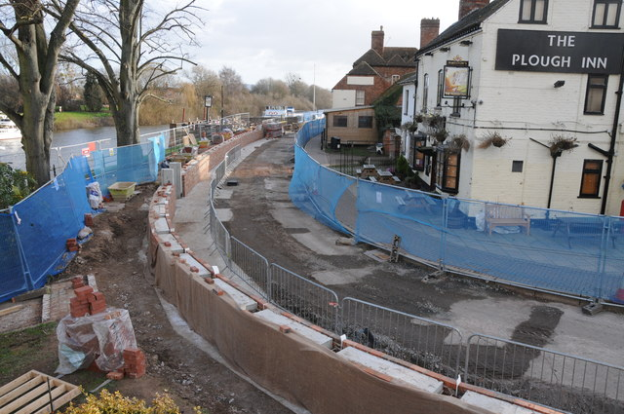
What is adaptation?
Adaptation refers to adjustments in our decision making, activities and structures that we make in response to observed or expected changes in climate. The focus is on:
reducing the real and potential damage caused by a changing climate
reducing vulnerability and increasing adaptive capacity
identifying potential opportunities arising from a changing climate
Thereby preparing for climate change and reducing the scale of its impacts.
Notes:
Delivery: SE
Welcome back. We hope those were useful preliminary discussions to get you thinking on what individual actions you might be able to take both at home and in your workplace. We are now going to move on to the final section of this session where we look at climate change adaptation.
ACTION: ask learners if anyone knows where this image was taken and what is happening.
This image was taken in Upton upon Severn and is a photo of work taking place to install flood defences. As some of you will know, Upton is a town that is very vulnerable to the effects of flooding, and to adapt to this, flood defences have been installed.
So, what is adaptation?
TIMECHECK: 1hr 40mins

Slide 20
Why is adaptation important?
Climate change impacts are already happening
Global average temperatures will continue to rise even if we put strong effective mitigation strategies in place now – ‘committed warming’
Ethics & climate justice – poor and vulnerable in society most at risk
Notes:
Delivery: SE
- Impacts are already happening, particularly in developing countries
- Committed warming – Intergovernmental Panel on Climate Change (IPCC) report released in autumn last year raised this as an imminent situation and highlighted the need to to devote much more money, time and resource to adapting to the impacts of climate change we are already experiencing
- Ethics and climate justice – we know from session two that the impacts of climate change are distributed unevenly...

Slide 21
Solutions: climate change adaptation
There are many high and low-tech solutions for adapting to the changing climate already in action, in progress or in the R&D phase. These are rarely 'one size fits all' solutions, most need to be tailored to specific people and places.
Examples include:
setting up early warning systems for extreme weather events
building flood defences
switching to drought resistant crops
genetically engineering more weather resistant crops
changing planning laws
increasing rain-water storage
Notes:
Delivery: SE
We know that around the world, climate change is already impacting lives and livelihoods, especially in the world’s poorest countries. Good adaptation can deliver good development. It can help improve lives, reduce poverty, protect the environment, and enhance resilience around the world. During COP26 (explain), which took place in November last year, adaptation was identified as a key priority, and the World Bank Group is committed to boosting support for adaptation and resilience.
ACTION: KB to screen share do not post in chat start at 5.55 stop 11.10
TIMECHECK: 1hr 50mins (after video)

Slide 22
IPCC June 2022 Adaptation summary
https://www.youtube.com/watch?v=SDRxfuEvqGg
Notes:
SE https://www.youtube.com/watch?v=SDRxfuEvqGg
Start video at 5.55 stop video at 11.10

Slide 23
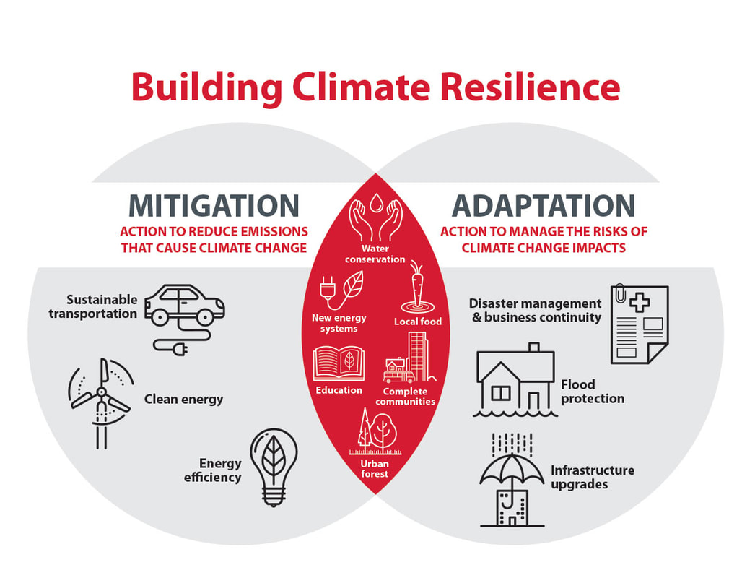
Summarizing adaptation and mitigation
Notes:
Delivery: SE
Together, mitigation and adaptation strategies create climate resilience. For us to maximise climate resilience both in the UK and around the world, it is important that we see both mitigation and adaptation actions.
Then hand over to Gill who will talk through some co-benefits

Slide 24
The co-benefits of climate solutions
‘Climate co-benefits are beneficial outcomes from climate actions that are not directly related to climate change mitigation. Such co-benefits include cleaner air, green job creation, public health benefits from active travel, and enhancing biodiversity through expanding/ enhancing green space.
Planning climate action that also delivers co-benefits can maximise opportunities to address multiple social, environmental, and economic challenges.’
Notes:
Delivery: GS
Trainer to introduce that we are moving on to look at co-benefits of climate action – read slide.
Understanding and being able to communicate the co-benefits of climate change is an important part of gaining support from individuals and groups to take climate action.
On the 31/01/23 we reached this slide at 15.19 (we had started at 14.00).

Slide 25
The co-benefits of renewable energy and energy efficiency measures
 | Better insulated homes reduce energy costs for residents
 | Improved air quality
 | Green jobs and upskilling the workforce Resilience to spikes in energy costs
Notes:
Delivery: GS
Trainer to mention that these are not exhaustive lists.

Slide 26
The co-benefits of electric vehicles and public/ active transport
 | Mental and physical health benefits
 | Improved air quality
 | Reduced noise pollution
 | Green jobs and upskilling the workforce
Notes:
Delivery: GS
Trainer to mention that these are not exhaustive lists.

Slide 27
The co-benefits of enhancing green space and biodiversity
 | Mental and physical health benefits
 | Improved air quality
 | Temperature management – reducing the urban heat island effect
 | Educational and community benefits
Notes:
Delivery: GS
Trainer to mention that these are not exhaustive lists.
Hand over to KB for final content before you can work in groups on looking at your own group solutions

Slide 28
Group actions: communicating about climate change
Being able to communicate about climate change is an important part of motivating and taking part in group actions for climate change.
Notes:
Delivery: KB
Link to video: https://www.youtube.com/watch?v=RkklaXhbTuA –
Duration: 4:01
Trainer to introduce that we are now going to be looking at how we can act on climate as a group. An important skill here is being able to communicate about climate change in a way that empowers others.
Trainer to explain that STO is a sustainability communication tool for the local Worcester area and invite participants to use STO following the training.

Slide 29
Activity: how do solutions at different levels interact for a net zero future?
The My 2050 tool brings together solutions at all levels and across all sectors and demonstrates how they can work together to achieve emissions reductions.
Use the tool to create a net zero future by adjusting the levers.
What does this tool reveal to you about climate change solutions?
Notes:
Delivery: KB
Link to tool: https://my2050.beis.gov.uk/?levers=111111111111111
Trainer to remind participants that over the past two sessions we have looked at a range of individual and societal solutions to climate change. To consolidate some of the learning from these sessions, we’re going to spend 10 minutes introducing the My 2050 tool – trainer to read the slide.
Trainer to briefly demonstrate the tool and how it works e.g. hovering over levers gives you more information etc.
Trainer to explain that this is a tool that takes a while to get to know in more depth, and that we are just introducing it for now. Participants are invited to return to the tool after the training and use it to support with their answer to Q5 on the assessment form.
ACTION: Trainer to post link in the chat box and give participants 5 minutes to familiarise themselves with the tool
ACTION: Participants invited to share learning from the tool in the chat box.

Slide 30
Group actions for climate: what should you consider?
Will the action reduce carbon emissions? To what extent?
What impacts will the action have on people?
What impacts will the action have on operations?
What resources does the action require?
Is the action practical and impactful?
Notes:
Delivery: KB
For the rest of the session, we’re going to focus on how we can plan and deliver group actions for climate change, and then we’ll have some time to chat through the assessment for anyone who is planning to complete this.
Trainer to introduce some key considerations around planning group action:
Will the action have a meaningful impact? Think about direct and indirect emissions here.
How will the action impact on people in your organisation e.g. access requirements.
How will the action impact on operations?
What resources will be required?

Slide 31
Group actions for climate: example ideas
‘I’m going to suggest that we start a de-branding and reusing/recycling process for workplace uniform’
‘I’m going to work with my team to strengthen sustainability requirements in our tendering processes’
‘I’m going to put forward the idea of sustainable investments and choosing green accounts to the Treasury team’
'I'm going to work with my team to prepare a business case for electric grounds maintenance equipment'
‘Dept. Children and Families annual conference for 200 students and staff. Sustainability theme golden thread’
Notes:
Delivery: KB
What actions are available to your team depend on your roles, the team you are a member of, and what your team’s day to day activities involve. It’s important when considering your group actions, that you’re planning an action that matches your collective capabilities as a team – it should be impactful and significant to your group or team.
On the slide, there are some examples of group actions you might pledge to take. This is not an exhaustive list, and we will be building on these ideas in a moment.
31/01/23 KB finished this slide at 15.39 after starting at 14.00

Slide 32
Groups actions for climate change: activity
Work together to develop ideas for group actions (relevant to the concerns highlighted in introductions) that each of you can take back to your teams at your organisation.
The purpose of this activity is to generate ideas for group actions that participants can take away and develop with colleagues after the training.
Notes:
Delivery: KB
For our final activity, we will be asking learners to work together and develop ideas for group actions that you can take back to your organisations and develop with your group/ team members.
Learners will be put into breakout rooms for 15-20 minutes. During this time, they should: (now read slide).
NOTE: trainer should provide an example of how this should work e.g.: in your group, someone introduces themselves as a member of a Grounds Maintenance Team and says one of their key concerns is around how to promote biodiversity on the land they maintain.
The group should then work together to suggest ideas for group actions that they can take back to his/ her/ their team.
The purpose of this activity is to generate ideas for group actions that participants can take away and develop with their teams after the training and evidence as part of group action section of assessment form.
Trainer to mention that if any groups are struggling for ideas, feel free to come back to the main room and ask a facilitator to join you. Once finished, groups can re-join the main room for discussion.
ACTION: put learners into breakout rooms

Slide 33
Assessment form guidance
Assessment forms are the only evidence that the Carbon Literacy Project uses to decide whether to certify learners – make sure your form reflects your understanding.
Your individual and group action should both be work-based (where possible), and it is important that your actions are measurable. In your response about individual and group action, try to include:
What the action you’re pledging is (remember to try and keep this work-based)
What steps you need to take to adopt it
How you could evidence the impact of your action
Notes:
Delivery:
Trainer to emphasise the guidance on the slide, with particular reference to the three bullet points.

Slide 34
Assessment form and questions
We now have some time for you to open and begin your assessment form/ ask any questions you have about the training/ assessment.
Assessment due date: 13 March 2023
Notes:
Delivery: KB
Come back to this after delivering next two slides because people who’ve already decided they’ll not be completing the assessment may want to go.
We now have some time for everyone to open up their assessment forms and jot down any notes or ideas they have from the session/ ask any questions.
Note: trainer to clarify low, medium, high activity for individual and group section of the form – we are not asking participants to go away and calculate the specific carbon impacts of their actions, the purpose of this exercise is for us to see that you have been able to distinguish between a high and lower impact solution.
Assessment due date is 13th March 2023 (note: this is generally not flexible as we require all assessment forms to be submitted within two weeks of completing the training).

Slide 35
Additional resources
The Energy Saving Trust
The Carbon Trust
Working from home: reducing your carbon footprint
Environmental Sustainability – Worcester City Council
Take Climate Action

Slide 36
Resources on climate change mitigation and adaptation
How bad are bananas? The carbon footprint of everything by Mike Berners-Lee
The Power of People – report by Jump and Arup
Can you reach net zero by 2050? Interactive game by the Financial Times
Nine things you can do about climate change by Grantham Institute
Adapting to a changing climate – video by the United Nations
https://www.sniffer.org.uk/blog/climate-change-risk-and-vulnerability-assessments
Notes:
Delivery: KB
Here are some excellent resources that we recommend you take a look at after today’s session. In particular, we recommend that you look at the Financial Times ‘can you reach net zero by 2050?’ game.

Slide 37
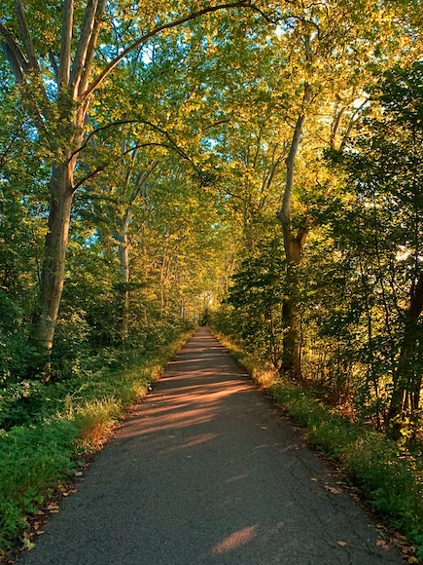
“Climate change is the single greatest threat to a sustainable future but, at the same time, addressing the climate challenge presents a golden opportunity to promote prosperity, security and a brighter future for all.”
Ban Ki-Moon, Former Secretary-General of UN
Notes:
Delivery: KB
Thank you everyone for attending – by completing this training and making your action pledges, you are being the change that we need to see to secure a positive, more sustainable future.
31.01.23 Ended with three minutes to spare

